Slide 1

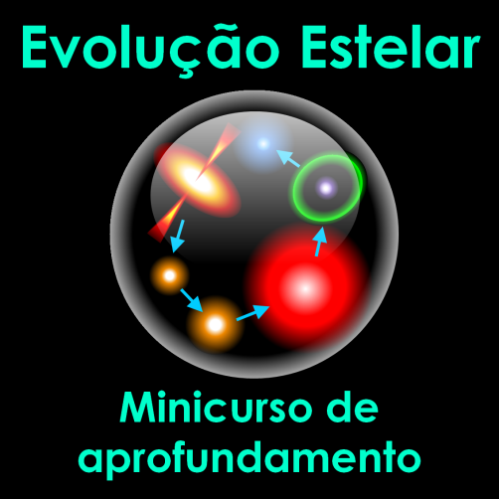

Centro de Divulgação da Astronomia
Observatório Dietrich Schiel
Sol – Uma Estrela
Jorge Hönel
Observatório Dietrich Schiel
/CDCC/USP
Imagem de fundo: céu de São Carlos na data de fundação do observatório Dietrich Schiel (10/04/86, 20:00 TL) crédito: Stellarium

Slide 2
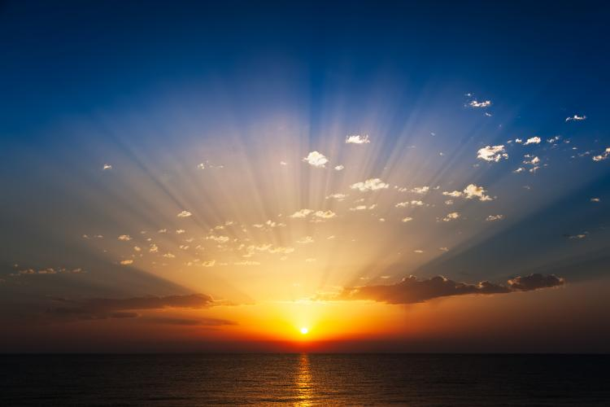
História do Sol
Notes:
http://c.tadst.com/gfx/750x500/sunrise.jpg?1
http://www.timeanddate.com/astronomy/about-sun-calculator.html

Slide 3
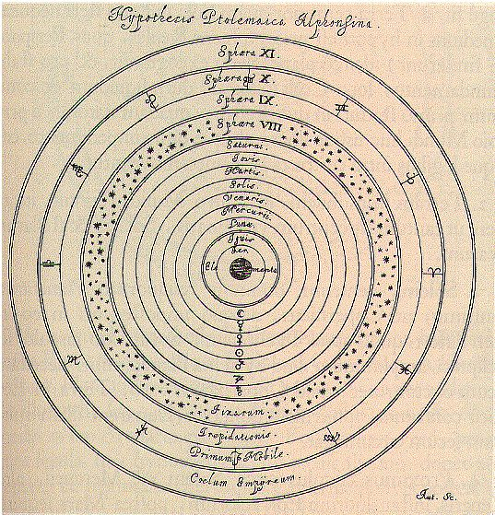
5 de Março de 1223 AC – Eclipse solar – Cidade de Ugarit na Síria
ca. 800 AC – Registro de mancha solar – China
384 AC a 322 AC - Aristóteles
Notes:
https://www2.hao.ucar.edu/Education/solar-physics-historical-timeline-1223-BC-250-BC

Slide 4
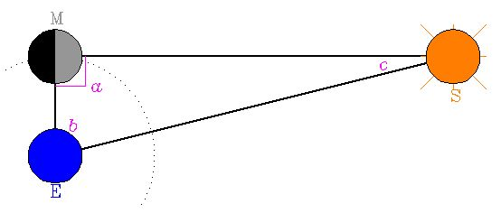
ca. 310-230 BC - Aristarco de Samos
Notes:
https://www2.hao.ucar.edu/Education/solar-physics-historical-timeline-1223-BC-250-BC

Slide 5
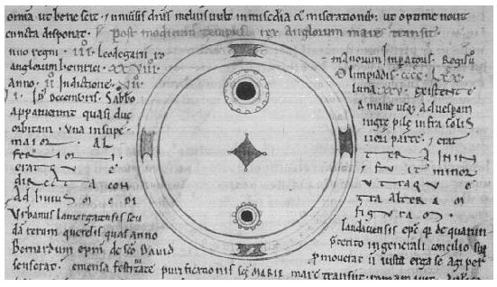
22 de dezembro de 968 Coroa Solar – Constantinopla por Leo Diaconus
08 de Dezembro de 1128 Crônicas de Worcester (John - monge)
Notes:
https://www2.hao.ucar.edu/Education/solar-physics-historical-timeline-0-1599

Slide 6
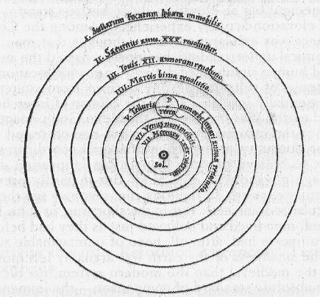
1 de maio de 1185 proeminências - Rússia
1543 Nicolau Copérnico - De revolutionibus orbium coelestium
Notes:
https://www2.hao.ucar.edu/Education/FamousSolarPhysicists/copernicus-writings

Slide 7
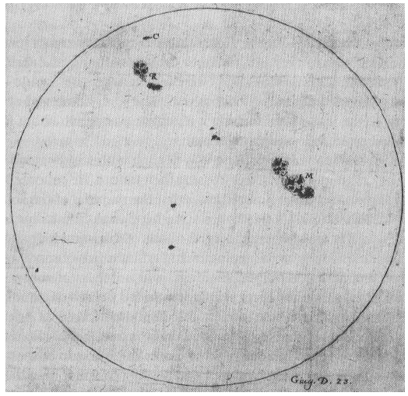
1609 – 1619 Johannes Kleper: o Sol está no foco das elipses
1610 Observações telescópicas do Sol por Galileu
Notes:
https://www2.hao.ucar.edu/Education/solar-physics-historical-timeline-1600-1799

Slide 8
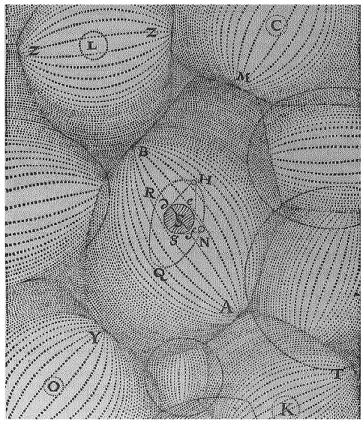
1644 O Sol é uma Estrela!!!!!!:
Principia Philosophiae de René Descartes
Notes:
https://www2.hao.ucar.edu/Education/solar-physics-historical-timeline-1600-1799

Slide 9
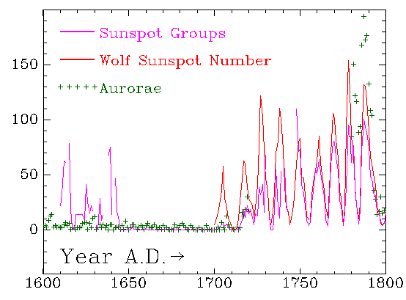
1645–1715 As Manchas Solares Desaparecem
Notes:
https://www2.hao.ucar.edu/Education/solar-physics-historical-timeline-1600-1799

Slide 10
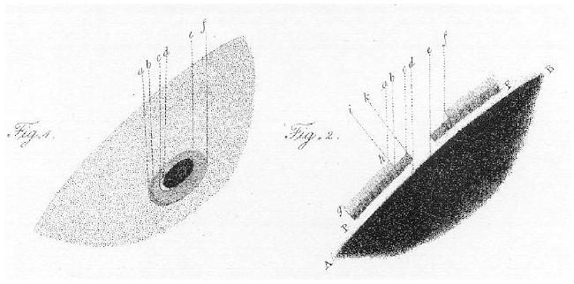
1687 A Massa do Sol –
Principia Mathematica de Sir Isaac Newton
M_{Sol}/M_{Terra} = 28 700 (332 945)
1774–1801 A Natureza Física das Manchas Solares (Willian Herschel)
Notes:
https://www2.hao.ucar.edu/Education/solar-physics-historical-timeline-1600-1799

Slide 11
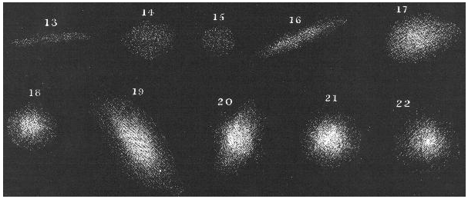
1796 A hipótese nebular e a origem do Sol
Willian Herschel (1738 – 1822)
Pierre Simon de Laplace (1749 –1827)
Exposition du Sistème du Monde - 1796

Slide 12
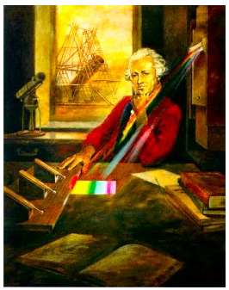
1800 – O infravermelho do Sol
Willian Herschel
Notes:
https://www2.hao.ucar.edu/Education/solar-physics-historical-timeline-1800-1999

Slide 13
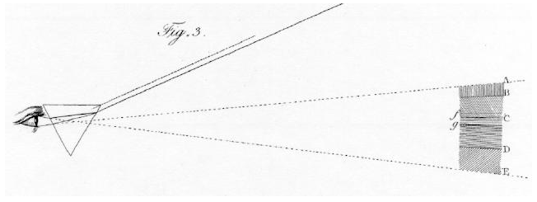
1802 – Linhas Escuras no Espectro do Sol
William Hyde Wollaston(1766-1828)
Notes:
https://www2.hao.ucar.edu/Education/solar-physics-historical-timeline-1800-1999

Slide 14
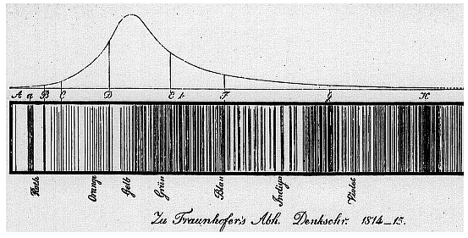
1817 – O Nascimento da Espectroscopia Solar
Joseph von Fraunhofer (1787–1826)
Notes:
https://www2.hao.ucar.edu/Education/solar-physics-historical-timeline-1800-1999

Slide 15
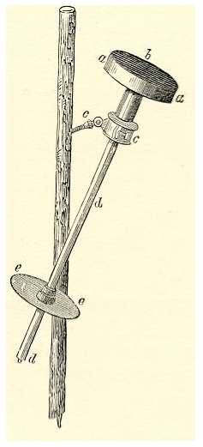
1838 – A Constante Solar
Claude Pouillet (1790–1868)
John Herschel (1792–1871)
Piroheliometro de Pouillet
Notes:
https://www2.hao.ucar.edu/Education/solar-physics-historical-timeline-1800-1999

Slide 16
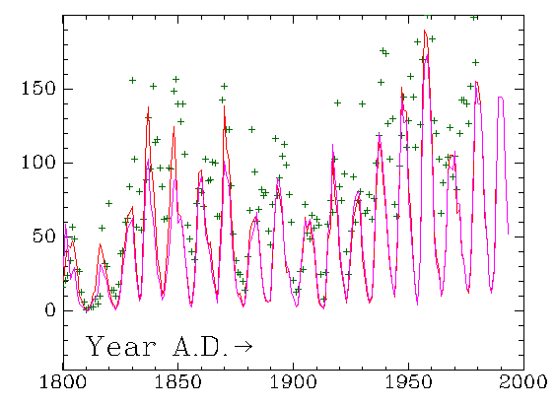
1843 –O Ciclo das Manchas Solares
Samuel Heinrich Schwabe (1789–1875)
Notes:
https://www2.hao.ucar.edu/Education/solar-physics-historical-timeline-1800-1999

Slide 17
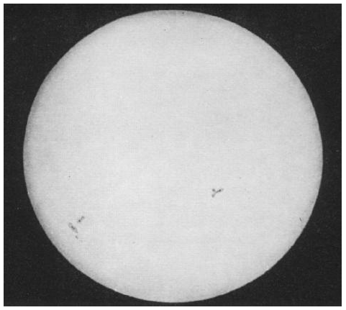
2 de abril 1845 – A Primeira fotografia Solar – Louis Fizaeu e Leon Foucault
John Herschel ( fotografia, negativo e positivo)
Notes:
https://www2.hao.ucar.edu/Education/solar-physics-historical-timeline-1800-1999

Slide 18
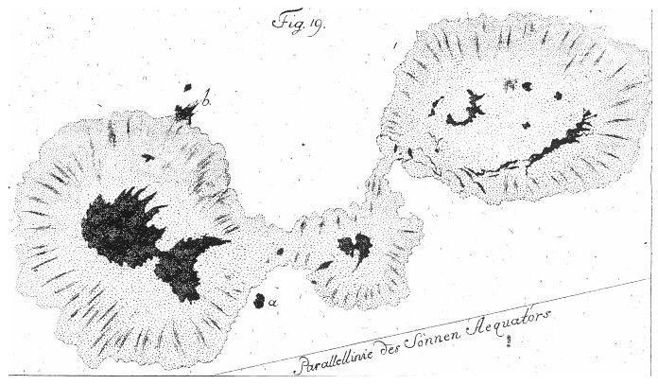
1848 – O Número Relativo de Manchas Solares
r = k (10 f +g) ; Rudolf Wolf (1816–1893)
Johann Hieronymus Schroeter (1745–1816) [10 anos]
Ciclo N° 4 (1785-1798)
Ciclo N° 1 (1755-1766)
Notes:
https://www2.hao.ucar.edu/Education/solar-physics-historical-timeline-1800-1999

Slide 19
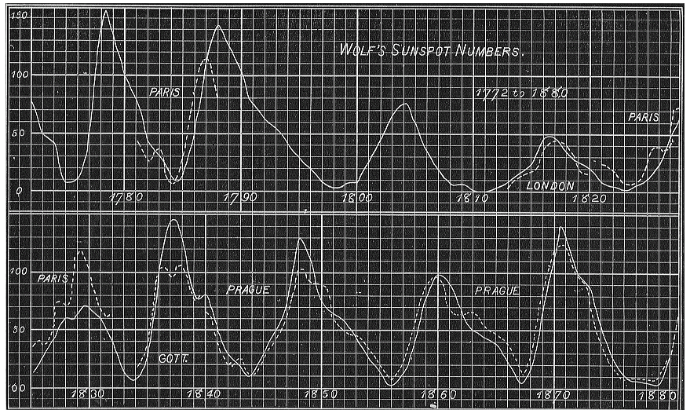
1852 – Manchas Solares e a Atividade Geomagnética da Terra
Samuel Heinrich Schwabe (1789–1875); Rudolf Wolf (1816–1893), Jean-Alfred Gautier (1793–1881) e Johann von Lamont (1805–1879)
Notes:
https://www2.hao.ucar.edu/Education/solar-physics-historical-timeline-1800-1999

Slide 20
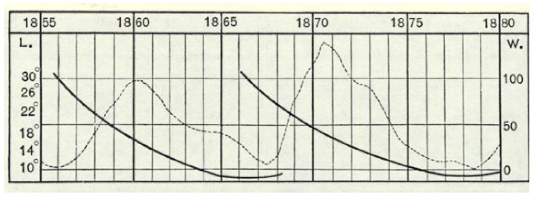
1858–1859 : Rotação Diferencial do Sol
Richard C. Carrington (1826–1875) – Inglaterra
Gustav Spörer (1822–1895) Alemanha
Lei da Migração das Manchas Solares de Spörer
Notes:
https://www2.hao.ucar.edu/Education/solar-physics-historical-timeline-1800-1999

Slide 21
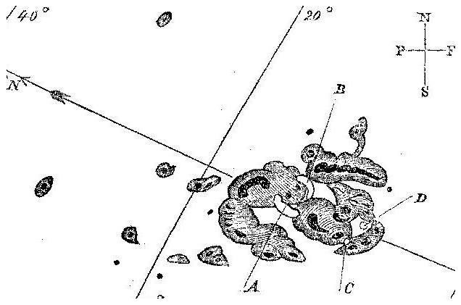
1859 – Observação do primeiro “flare”
Richard C. Carrington (1826–1875)
R. Hodgson (1804–1872)
Richard C. Carrington
Notes:
https://www2.hao.ucar.edu/Education/solar-physics-historical-timeline-1800-1999

Slide 22
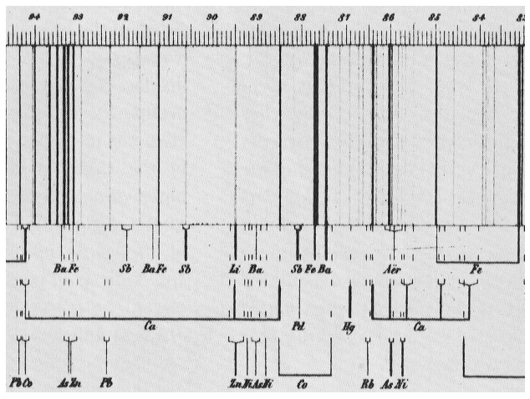
1859 –The chemical composition of the Sun
Robert Wilhelm Bunsen (1811–1899) –químico
Gustavo Kirchhoff (1824–1887) - físico
Gustav Kirchoff - 1863
Notes:
https://www2.hao.ucar.edu/Education/solar-physics-historical-timeline-1800-1999

Slide 23
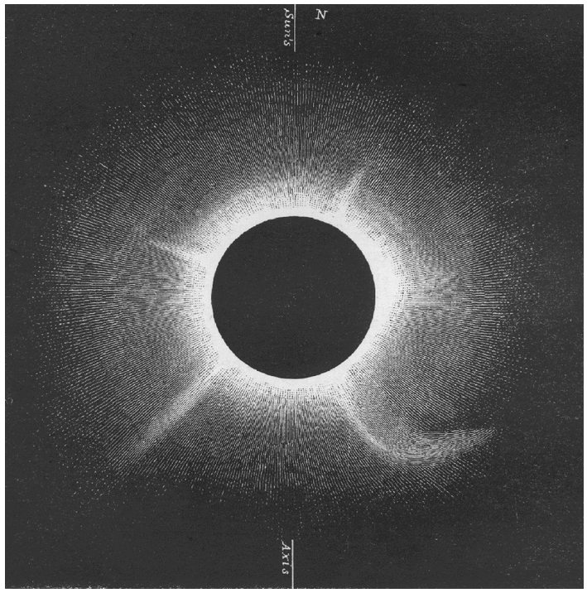

18 Julho de 1860 – Primeira Observação de Ejeção de Massa Coronal
G. Tempel,
von Feilitzsch,
F.A. Oom,
E.W. Murray,
F. Galton, and
C. von Wallenberg.
F. A. Oom
Notes:
https://www2.hao.ucar.edu/Education/solar-physics-historical-timeline-1800-1999

Slide 24
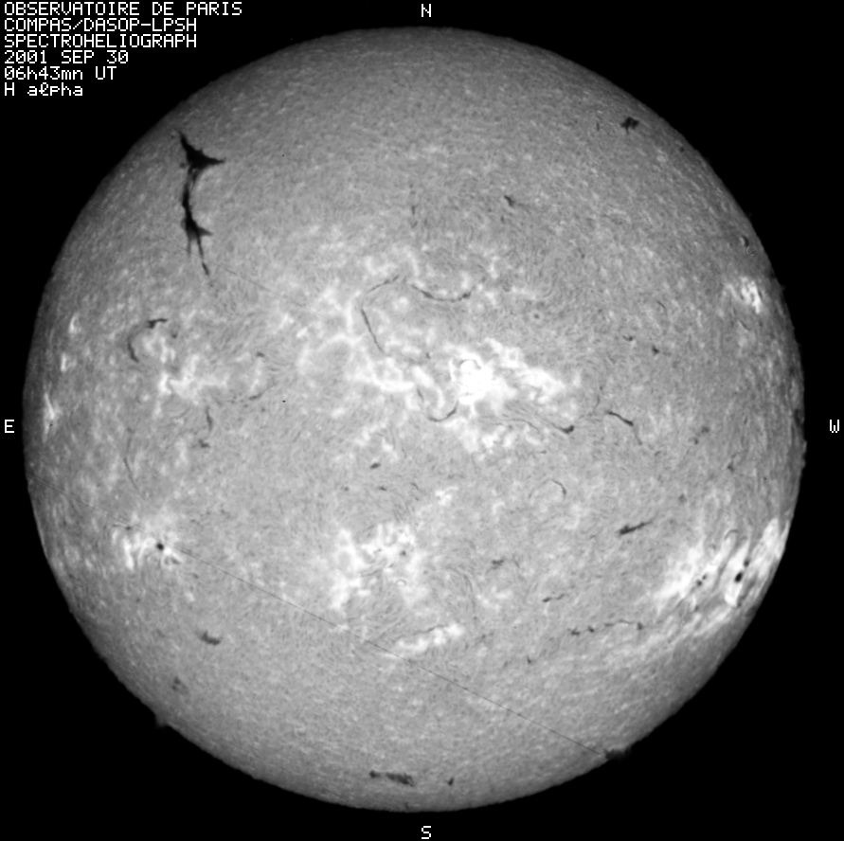
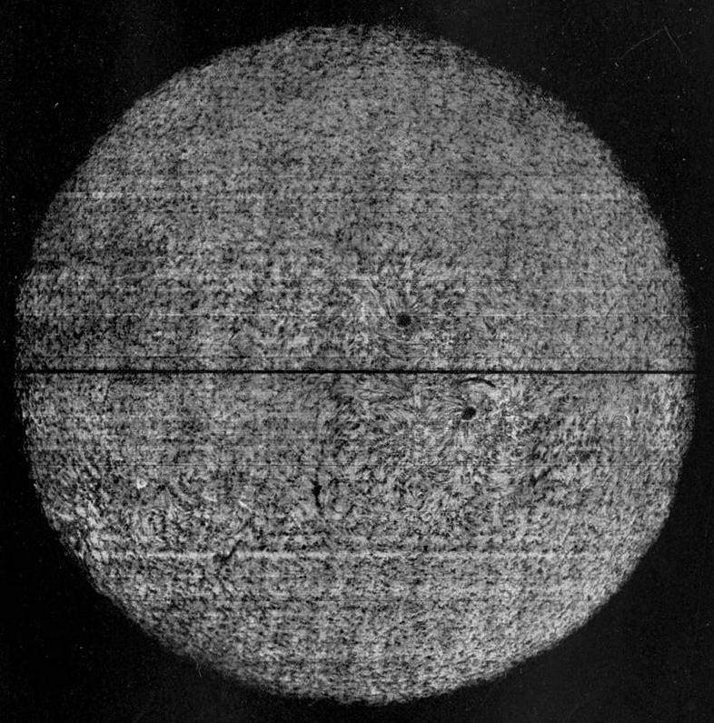
1870-1890 – Espectroheliografo
1889 - George Ellery Halle (29/06/1868 – 21/02/1938)
Henri Alexandre Deslandres (24/07/1853 – 15/01/1948)
Robert Raynolds McMath (11/06/1891 – 02/01/1962)
7/10/1908 – Monte Wilson
Notes:
https://www.aip.org/history/cosmology/tools/tools-spectroscopy.htm
https://en.wikipedia.org/wiki/Spectroheliograph
http://bass2000.bagn.obs-mip.fr/New2003/Pages/Instruments/mh010930.064300.gif
http://bass2000.bagn.obs-mip.fr/New2003/Pages/Instruments/image_spectro_meudon.html
https://en.wikisource.org/wiki/1911_Encyclopædia_Britannica/Spectroheliograph#/media/File:Britannica_Spectroheliograph_photo.jpg
https://en.wikisource.org/wiki/1911_Encyclopædia_Britannica/Spectroheliograph

Slide 25
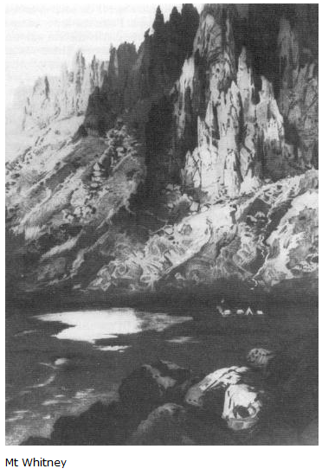
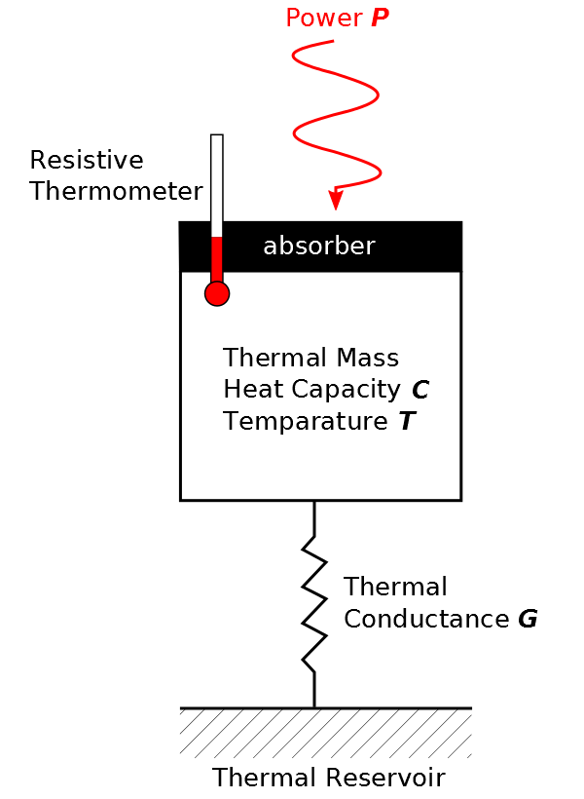

Julho de 1881 – Medindo novamente a Constante Solar
Samuel Pierpont Langley (1834–1906) – americano
Bolômetro
Notes:
https://www2.hao.ucar.edu/Education/solar-physics-historical-timeline-1800-1999
Bolometro: https://en.wikipedia.org/wiki/Bolometer

Slide 26
1905 – 1939 : A Fusão Nuclear
1905 – Albert Einstein - E = m c²
1920 - Francis William Aston (químico) – massas dos átomos
1920 - Sir Arthur Eddington, (astrofísico) transformação do hidrogênio em hélio
1928 – Decaimento Alpha por Efeito Tunel (George Gamov,
Ronald Gurney e Edward Condon)
1939 - Hans Bethe – alemão – modelo quantitativo para a fusão nuclear no Sol
Notes:
http://ec.europa.eu/research/energy/euratom/index_en.cfm?pg=fusion&section=history

Slide 27
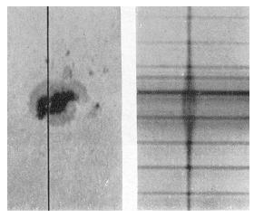
1908 – A natureza magnética das Manchas Solares
Efeito Zeeman – (1896) por Pieter Zeeman - holandês
Efeito Zeeman por indução magnética no espectro de uma mancha solar (artigo de 1919) por G.E. Hale, F. Ellerman, S.B. Nicholson e A.H. Joy
Notes:
https://www2.hao.ucar.edu/Education/solar-physics-historical-timeline-1800-1999
Hale, G.E. 1908, On the probable existence of a magnetic field in sunspots, The Astrophysical Journal, 28, pps. 315–343,
Stix, M. 1989, The Sun, Springer.
The Astrophysical Journal, vol. 49, pps. 153-178).

Slide 28
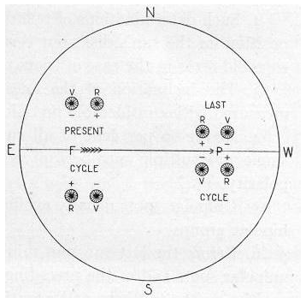
1919 – O Ciclo Magnético do Sol
Lei da Polaridade de Hale: por G.E. Hale, F. Ellerman, S.B. Nicholson e A.H. Joy
The Astrophysical Journal, vol. 49, pps. 153–178
Notes:
https://www2.hao.ucar.edu/Education/solar-physics-historical-timeline-1800-1999
The Astrophysical Journal, vol. 49, pps. 153–178)

Slide 29
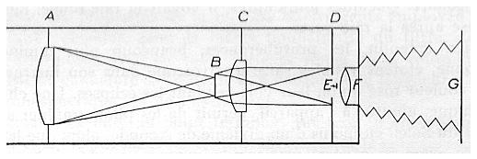
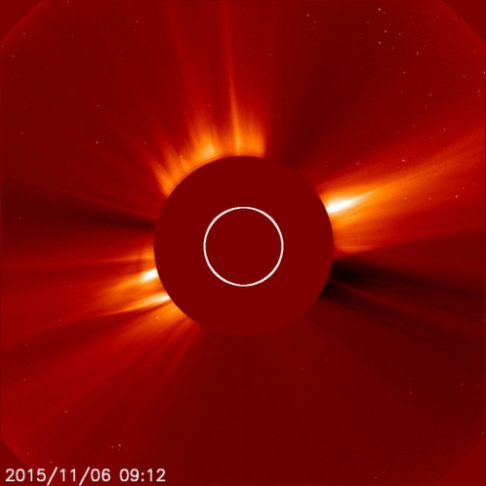
1931 – O Coronógrafo
Bernard Ferdinand Lyot (27/02/1897 a 02/04/1952)
Notes:
https://www2.hao.ucar.edu/Education/solar-physics-historical-timeline-1800-1999
http://sohowww.nascom.nasa.gov/data/realtime/c2/512/
http://sohowww.nascom.nasa.gov/data/realtime/c2/1024/latest.html
http://sohowww.nascom.nasa.gov/data/realtime/c2/1024/latest.jpg

Slide 30
Final da Parte 01/02
Notes:
https://www2.hao.ucar.edu/Education/solar-physics-historical-timeline-1800-1999

Slide 31

Solar Dynamics Observatory - SDO
Notes:
https://youtu.be/piuKlpJmjfg
http://solarsystem.nasa.gov/planets/sun

Slide 32
Observatórios Solares Espaciais
HELIOS-A (1974); HELIOS-B (1976); ISEE-3 (1978); Ulysses (1990); Yohkoh (1991)
WIND (1994); SOHO (1995); ACE (1997); TRACE (1998) GENESIS (2001); HINODE (2006);
STEREO (2006); Solar Dynamics Observatory (2010); PICARD (2010);
IRIS (2013); DSCOVR (2015);
Futuras
Adytia (2017-2018); Solar Probe Plus (2018);
SOLO (2018);
Notes:
https://en.wikipedia.org/wiki/Timeline_of_Solar_System_exploration

Slide 33
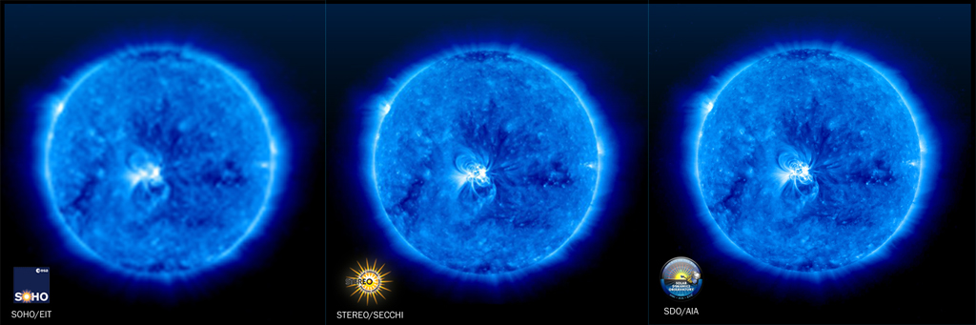
Observatórios Solares Espaciais
SOHO (1995)
Stereo (2006)
Solar Dynamics Observatory (2010)
Uma imagem a cada:
12 minutos
3 minutos
1 segundo
Notes:
http://sdo.gsfc.nasa.gov/mission/instruments.php
Image Resolution Comparison
The following image illustrates the resolution capabilities of the SDO, STEREO, and SOHO spacecrafts. SDO's AIA instrument (right image) has twice the image resolution than STEREO (middle image) and 4 times greater imaging resolution than SOHO (left image). The image cadence also varies. SDO takes 1 image every second. At best STEREO takes 1 image every 3 minutes and SOHO takes 1 image every 12 minutes.
http://sdo.gsfc.nasa.gov/assets/img/site/resolution_comparison.jpg

Slide 34
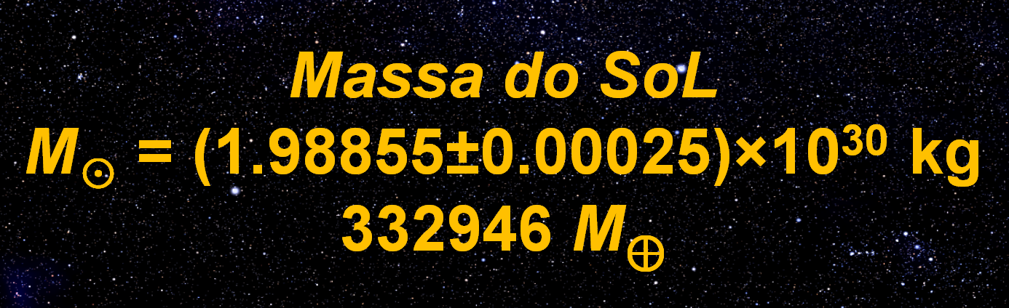

Slide 35
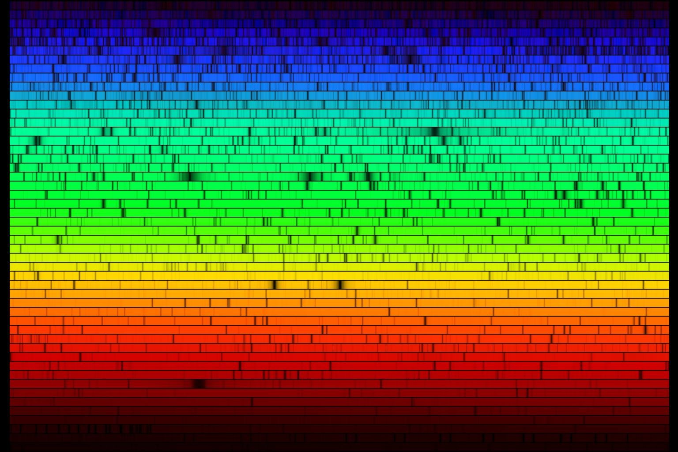
Espectro do Sol
Notes:
http://www.http.com//chinook.kpc.alaska.edu/~ifafv/lecture/miscell/fraunhof/sun_spectrum.jpg

Slide 36
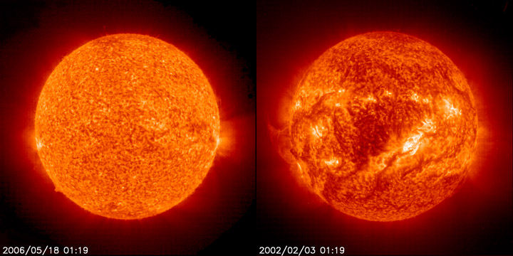
Características (cerca 67 elementos químicos)
Elemento | Abundância (% do total de número de átomos) | Abundância (% do total de massa)
Hidrogênio | 91.2 | 71.0
Hélio | 8.7 | 27.1
Oxigênio | 0.078 | 0.97
Carbono | 0.043 | 0.40
Nitrogênio | 0.0088 | 0.096
Silicío | 0.0045 | 0.099
Magnésio | 0.0038 | 0.076
Nêonio | 0.0035 | 0.058
Ferro | 0.030 | 0.014
Enxofre | 0.015 | 0.040
Notes:
These pictures show the Sun in ultraviolet "light". The left picture was at "solar min". The right picture was at "solar max". This UV wavelength (30.4 nanometers) helps scientists see certain parts of the Sun's atmosphere. The UV "light" is given off by helium at temperatures around 60,000 to 80,000 kelvins.
Images courtesy of SOHO (NASA & ESA).
http://www.windows2universe.org/php/gallery/gallery.php?id=193
http://solarsystem.nasa.gov/planets/profile.cfm?Object=Sun&Display=Facts&System=Metric
http://chemistry.about.com/b/2010/06/15/chemical-composition-of-the-sun.htm
http://hyperphysics.phy-astr.gsu.edu/hbase/tables/suncomp.html#c1

Slide 37
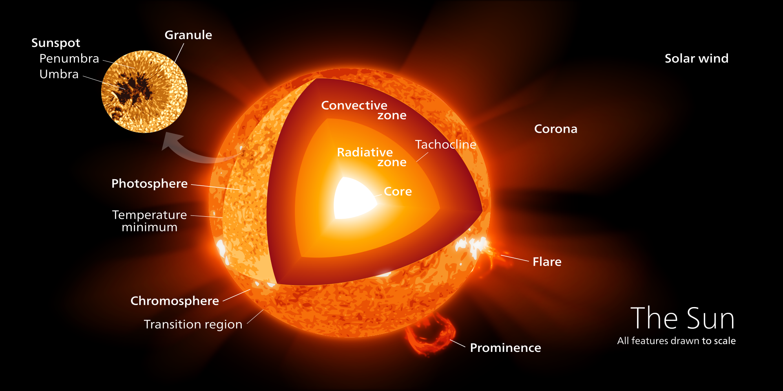
Estrutura do Sol
Notes:
https://upload.wikimedia.org/wikipedia/commons/d/d4/Sun_poster.svg

Slide 38
Estrutura Interna | Núcleo Zona de Radiação Tachocline Zona de Convecção
Atmosfera
Fotosfera | Supergranulação Grânulos Fácula Manchas Solares Filamentos (proeminências) Flare – “lampejo”
Cromosfera | Plage “praia” Espículos Onda Moreton
Coroa | Região de Transição Buraco Coronal Laço Coronal Ejeção de Massa Coronal Proeminência (filamentos) Fluxo Helmet
Notes:
https://en.wikipedia.org/wiki/Sun

Slide 39
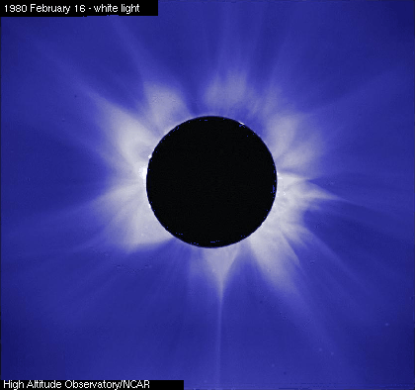
Coroa
Fluxo Helmet
Notes:
https://upload.wikimedia.org/wikipedia/commons/c/cf/Helmet_streamers_at_max.gif
https://en.wikipedia.org/wiki/Helmet_streamer
Helmet streamers are bright loop-like structures which develop over active regions on the sun. They are closed magnetic loops which connect regions of opposite magnetic polarity. Electrons are captured in these loops, and cause them to glow very brightly. The solar wind elongates these loops to pointy tips. They far extend above most prominences into the corona, and can be readily observed during a solar eclipse. Helmet streamers are usually confined to the "streamer belt" in the mid latitudes, and their distribution follows the movement of active regions during the solar cycle. Small blobs of plasma, or "plasmoids" are sometimes released from the tips of helmet streamers, and this is one source of the slow component of the solar wind. In contrast, formations with open magnetic field lines are called coronal holes, and these are darker and are a source of the fast solar wind. Helmet streamers can also create coronal mass ejections if a large volume of plasma becomes disconnected near the tip of the streamer.

Slide 40
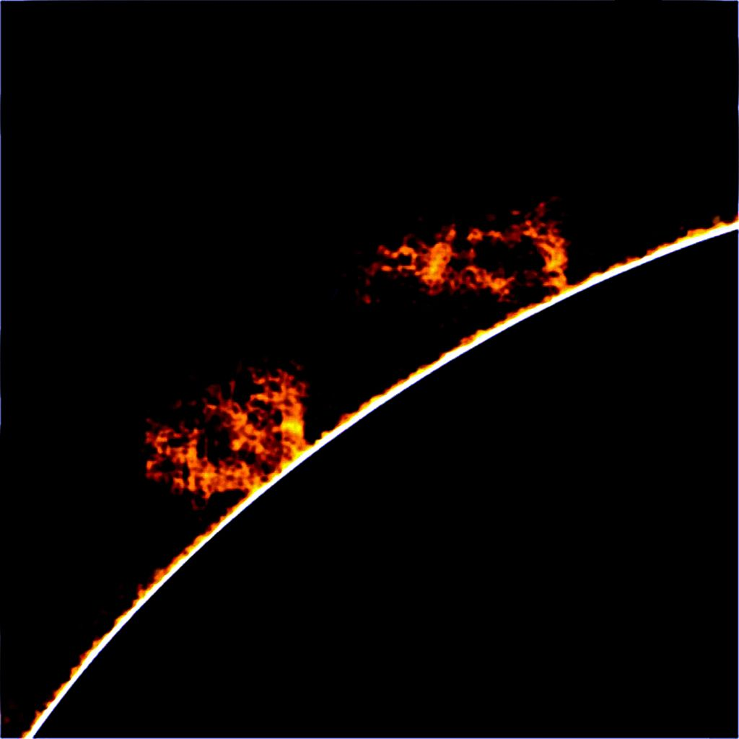
Coroa
Proeminência
Notes:
https://en.wikipedia.org/wiki/Solar_prominence#/media/File:Solar_prominence_1.jpg
https://en.wikipedia.org/wiki/Solar_prominence
A prominence is a large, bright, gaseous feature extending outward from the Sun's surface, often in a loop shape. Prominences are anchored to the Sun's surface in the photosphere, and extend outwards into the Sun's corona. While the corona consists of extremely hot ionized gases, known as plasma, which do not emit much visible light, prominences contain much cooler plasma, similar in composition to that of the chromosphere. The prominence plasma is typically a hundred times cooler and denser than the coronal plasma. A prominence forms over timescales of about a day, and prominences may persist in the corona for several weeks or months. Some prominences break apart and may then give rise to coronal mass ejections. Scientists are currently researching how and why prominences are formed.
A prominence forms over timescales of about a day, and stable prominences may persist in the corona for several months, looping hundreds of thousands of miles into space.
The red-glowing looped material is plasma, a hot gas composed of electrically charged hydrogen and helium. The prominence plasma flows along a tangled and twisted structure of magnetic fields generated by the sun’s internal dynamo. An erupting prominence occurs when such a structure becomes unstable and bursts outward, releasing the plasma.
A typical prominence extends over many thousands of kilometers; the largest on record was estimated at over 800,000 kilometres (500,000 mi) long^{[1]} – roughly the radius of the Sun.

Slide 41
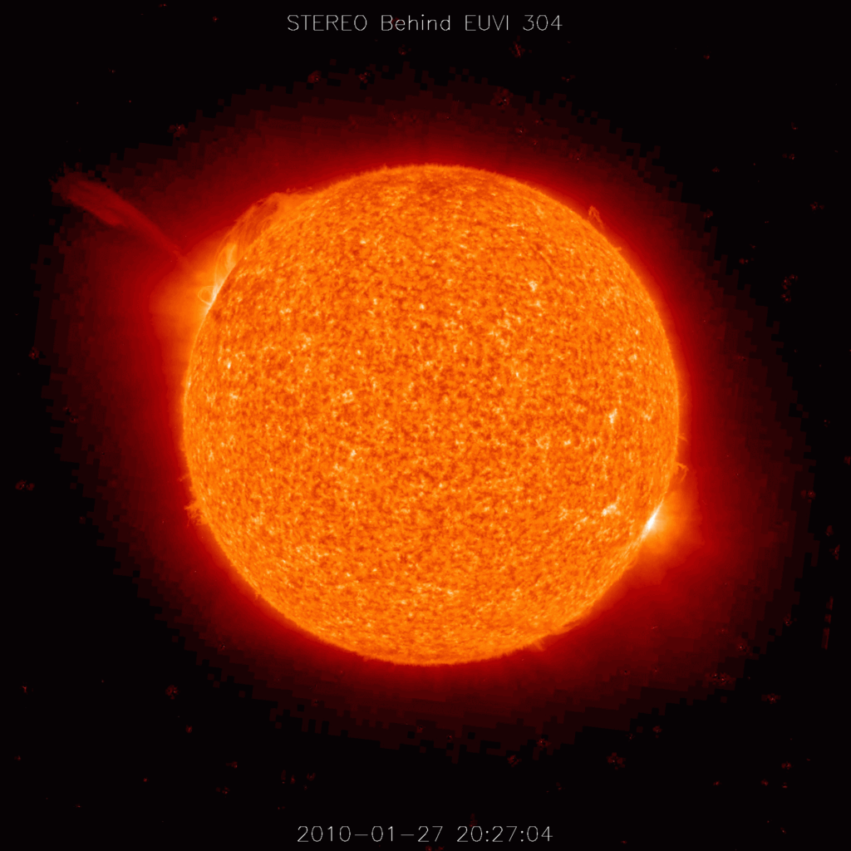
Coroa
Ejeção de Massa Coronal
Notes:
https://en.wikipedia.org/wiki/Coronal_mass_ejection#/media/File:Coronal_Mass_Ejection.gif
https://en.wikipedia.org/wiki/Coronal_mass_ejection
A coronal mass ejection (CME) is a massive burst of gas and magnetic field arising from the solar corona and being released into the solar wind, as observed in a coronagraph.^{[1]}
Coronal mass ejections are often associated with other forms of solar activity, most notably solar flares or filament eruptions, but a broadly accepted theoretical understanding of these relationships has not been established. CMEs most often originate from active regions on the Sun's surface, such as groupings of sunspots associated with frequent flares. Near solar maxima, the Sun produces about three CMEs every day, whereas near solar minima, there is about one CME every five days.^{[2]}

Slide 42
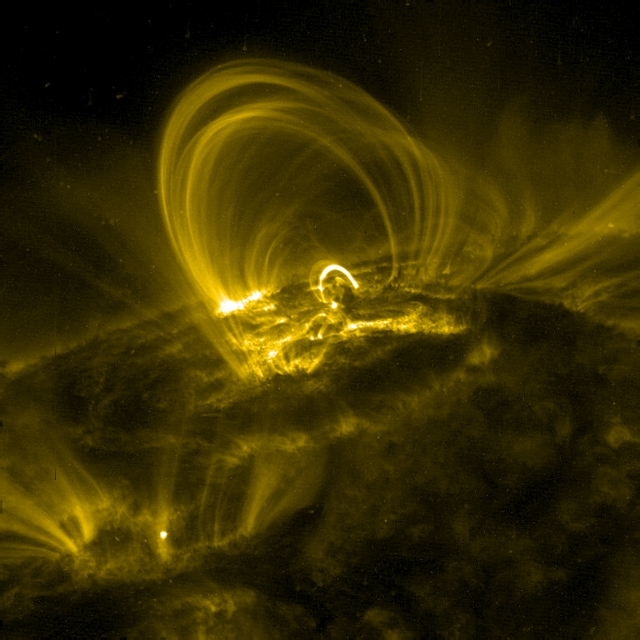
Coroa
Laço Coronal
Notes:
https://en.wikipedia.org/wiki/Coronal_loop#/media/File:Traceimage.jpg
https://en.wikipedia.org/wiki/Coronal_loop
Coronal loops form the basic structure of the lower corona and transition region of the Sun. These highly structured loops are a direct consequence of the twisted solar magnetic flux within the solar body. The population of coronal loops can be directly linked with the solar cycle; it is for this reason coronal loops are often found with sunspots at their footpoints. The upwelling magnetic flux pushes through the photosphere, exposing the cooler plasma below. The contrast between the photosphere and the solar interior gives the impression of dark spots, or sunspots.

Slide 43
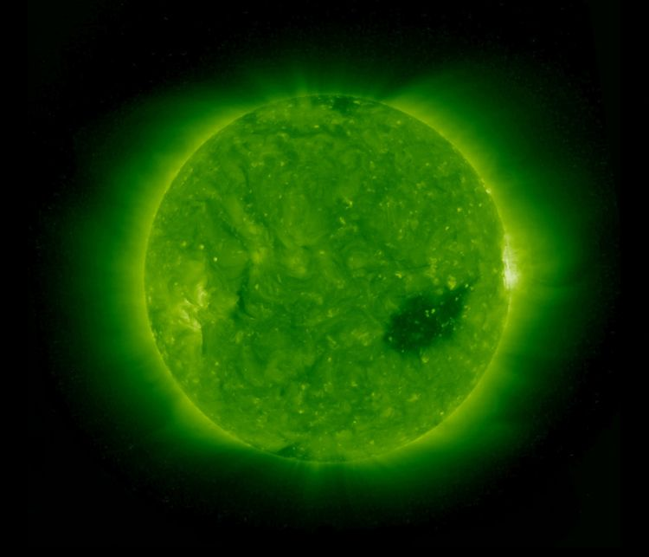
Coroa
Buraco Coronal
Notes:
https://upload.wikimedia.org/wikipedia/commons/8/83/Coronalhole.jpg
https://en.wikipedia.org/wiki/Coronal_hole
Coronal holes are part of the Sun's corona and are constantly changing and reshaping because the corona is not uniform.^{[1]} Coronal holes are areas where the Sun's corona is darker, and colder, and has lower-density plasma than average because there is lower energy and gas levels. The sun contains magnetic fields that arch away from areas in the corona that are very thin due to the lower levels of energy and gas,^{[1]} which cause coronal holes to appear when they do not fall back. Thus, solar particles or solar wind escape and create a lower density and lower temperature in that area.^{[2]} The aurora borealis that is seen at the northern and southern poles are the result of solar wind entering the Earth’s atmosphere.^{[1]}

Slide 44
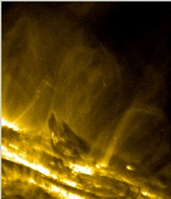
Coroa
Região de Transição
Notes:
https://upload.wikimedia.org/wikipedia/commons/5/5d/Transition-region.jpg
TRACE 19.5 nm wavelength image of the solar corona with a dark prominence at lower center. The transition region is visible as a low, bright fog over the surface of the Sun and perhaps as a thin bright nimbus around the prominence itself. The large, bright structures are magnetic loops in the solar corona.

Slide 45

Cromosfera
Onda Moreton
Notes:
https://upload.wikimedia.org/wikipedia/en/f/f6/MoretonWaveAnimation200612.gif
Animation of a Moreton wave which occurred on December 6, 2006
https://en.wikipedia.org/wiki/Moreton_wave
A Moreton wave is the chromospheric signature of a large-scale solar coronal shock wave. Described as a kind of solar "tsunami",^{[1]} they are generated by solar flares. They are named for American astronomer Gail Moreton, an observer at the Lockheed Solar Observatory in Burbank who spotted them in 1959.^{[2][3][4]} He discovered them in time-lapse photography of the chromosphere in the light of the Balmer alpha transition.
There were few follow-up studies for decades. Then the 1995 launch of the Solar and Heliospheric Observatory led to observation of coronal waves, which cause Moreton waves. Moreton waves were a research topic again. (SOHO's EIT instrument discovered another, different wave type called "EIT waves".) ^{[5]} The reality of Moreton waves (aka fast-mode MHD waves) has also been confirmed by the two STEREO spacecraft. They observed a 100,000-km-high wave of hot plasma and magnetism, moving at 250 km/s, in conjunction with a big coronal mass ejection in February 2009.^{[6][7]}
Solar Tsunami
Moreton waves propagate at a speed of 500–1500 km/s (this range does not agree with the just-quoted STEREO observation of a 250 km/s speed). Yutaka Uchida interpreted Moreton waves as MHD fast mode shock waves propagating in the corona.^{[8]} He links them to type II radio bursts, which are radio-wave discharges created when coronal mass ejections accelerate shocks.^{[9]}
Moreton waves can be observed primarily in the Hα band.^{[10]}

Slide 46
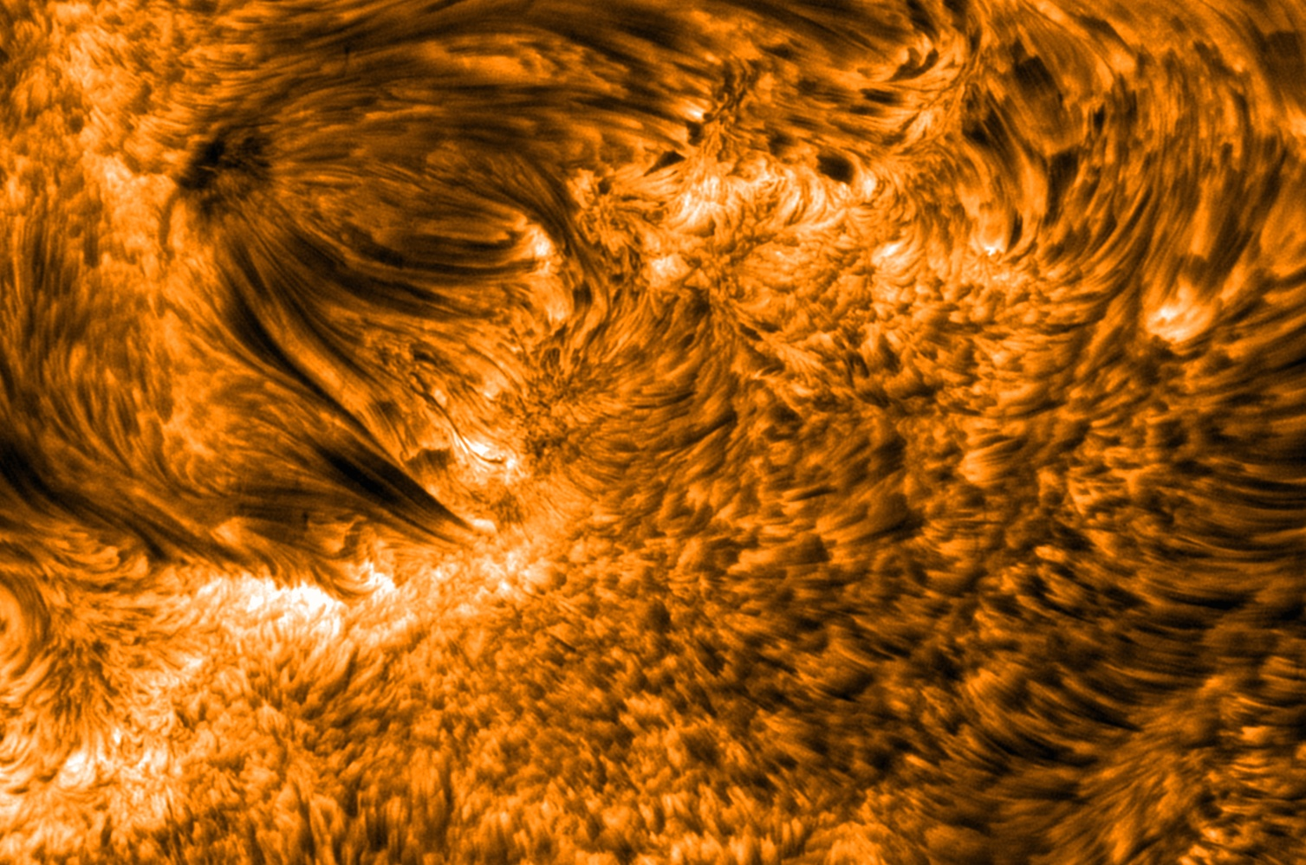
Cromosfera - Espículos
Notes:
https://en.wikipedia.org/wiki/Spicule_(solar_physics)#/media/File:Spicules_sst_big.jpg
Spicules, visible as dark tubes. Solar active region 10380, June 2004
https://en.wikipedia.org/wiki/Spicule_(solar_physics)
In solar physics, a spicule is a dynamic jet of about 500 km diameter in the chromosphere of the Sun. It moves upwards at about 20 km/s from the photosphere. They were discovered in 1877 by Father Angelo Secchi of the Vatican Observatory in Rome.
Spicules last for about 15 minutes;^{[1]} at the solar limb they appear elongated (if seen on the disk, they are known as "mottles" or "fibrils"). They are usually associated with regions of high magnetic flux; their mass flux is about 100 times that of the solar wind. They rise at a rate of 20 km/s (or 72,000 km/h) and can reach several thousand kilometers in height before collapsing and fading away.

Slide 47
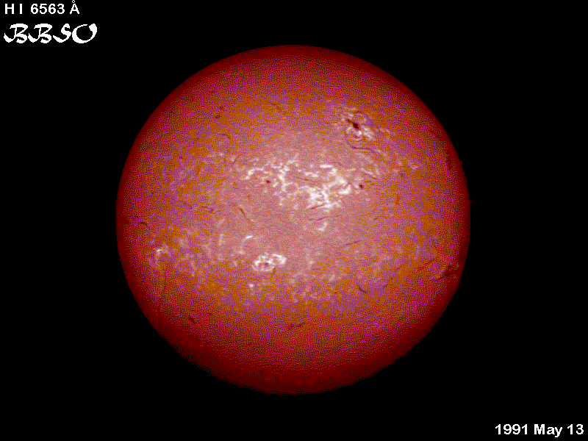
Cromosfera - Plage
Notes:
http://solarscience.msfc.nasa.gov/feature2.shtml
https://en.wikipedia.org/wiki/Plage_(astronomy)
A plage is a bright region in the chromosphere of the Sun, typically found in regions of the chromosphere near sunspots. The term itself is poetically taken from the French word for "beach". The plage regions map closely to the faculae in the photosphere below, but the latter have much smaller spatial scales. Accordingly, plage occurs most visibly near a sunspot region. Faculae have a strong influence on the solar constant, and the more readily detectable (because chromospheric) plage areas traditionally are used to monitor this influence. In this context "active network" consists of plage-like brightenings extending away from active regions as their magnetism appears to diffuse into the quiet Sun, but constrained to follow the network boundaries.
Because we can explain faculae with the strictly photospheric "hot wall" model,^{[1]} it is not clear what the actual physical relationship between plage and faculae may be.

Slide 48
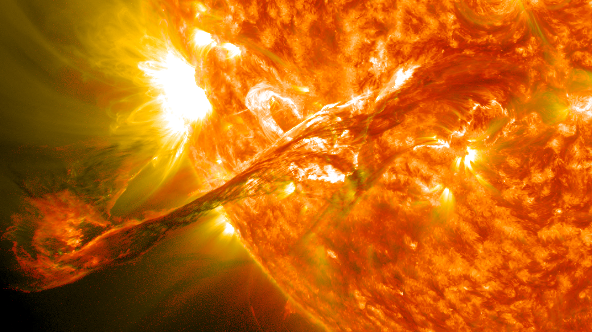
SDO - 31/08/2012 – 20:36 UTC
Fotosfera - Flare
Notes:
https://en.wikipedia.org/wiki/Solar_flare#/media/File:Magnificent_CME_Erupts_on_the_Sun_-_August_31.jpg
On August 31, 2012 a long filament of solar material that had been hovering in the sun's atmosphere, the corona, erupted out into space at 20:36 UTC. The coronal mass ejection, or CME, traveled at over 900 miles per second. The CME did not travel directly toward Earth, but did connect with Earth's magnetic environment, or magnetosphere, causing aurora to appear on the night of Monday, September 3. Pictured here is a lighten blended version of the 304 and 171 angstrom wavelengths taken from the Solar Dynamics Observatory. Cropped
https://en.wikipedia.org/wiki/Solar_flare
A solar flare is a sudden flash of brightness observed near the Sun's surface. It involves a very broad spectrum of emissions, requiring an energy release of up to 6 × 10²⁵ joules of energy (roughly the equivalent of 160,000,000,000 megatons of TNT, over 25,000 times more energy than released from the impact of Comet Shoemaker–Levy 9 with Jupiter). Flares are often, but not always, accompanied by a spectacular coronal mass ejection.^{[1]} The flare ejects clouds of electrons, ions, and atoms through the corona of the sun into space. These clouds typically reach Earth a day or two after the event.^{[2]} The term is also used to refer to similar phenomena in other stars, where the term stellar flare applies.
Solar flares affect all layers of the solar atmosphere (photosphere, chromosphere, and corona), when the plasma medium is heated to tens of millions of Kelvin, while the cosmic-ray-like electrons, protons, and heavier ions are accelerated to near the speed of light. They produce radiation across the electromagnetic spectrum at all wavelengths, from radio waves to gamma rays, although most of the energy is spread over frequencies outside the visual range and for this reason the majority of the flares are not visible to the naked eye and must be observed with special instruments. Flares occur in active regions around sunspots, where intense magnetic fields penetrate the photosphere to link the corona to the solar interior. Flares are powered by the sudden (timescales of minutes to tens of minutes) release of magnetic energy stored in the corona. The same energy releases may produce coronal mass ejections (CME), although the relation between CMEs and flares is still not well established.
X-rays and UV radiation emitted by solar flares can affect Earth's ionosphere and disrupt long-range radio communications. Direct radio emission at decimetric wavelengths may disturb the operation of radars and other devices that use those frequencies.
Solar flares were first observed on the Sun by Richard Christopher Carrington and independently by Richard Hodgson in 1859^{[3]} as localized visible brightenings of small areas within a sunspot group. Stellar flares can be inferred by looking at the lightcurves produced from the telescope or satellite data of variety of other stars.
The frequency of occurrence of solar flares varies, from several per day when the Sun is particularly "active" to less than one every week when the Sun is "quiet", following the 11-year cycle (the solar cycle). Large flares are less frequent than smaller ones.
On July 23, 2012, a massive, and potentially damaging, solar superstorm (solar flare, coronal mass ejection, solar EMP) barely missed Earth, according to NASA.^{[4][5]} There is an estimated 12% chance of a similar event occurring between 2012 and 2022.[

Slide 49
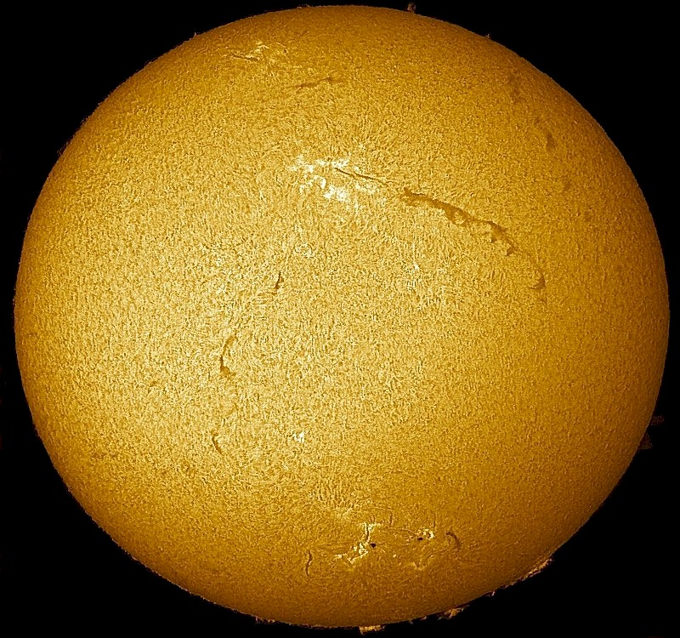
06/12/2004 – Telescópio H-Alpha
Fotosfera - Filamento
Notes:
http://apod.nasa.gov/apod/ap041206.html
Explanation: Two unusually long filaments crossed part of the Sun last week. The filaments are actually relatively cool and dark prominences of solar plasma held up by the Sun's magnetic field but seen against the face of the Sun. Filaments typically last a few weeks before falling back. Pictured above, the two filaments are visible on the Sun's right side. It would take twenty Earths, set end-to-end, to match the length of one of the filaments. Also visible are bright hot regions called plages and a carpet of hundreds of granules that provide the Sun's texture. The above image was taken early last week through a small telescope in a very specific color of light emitted primarily by hydrogen.

Slide 50
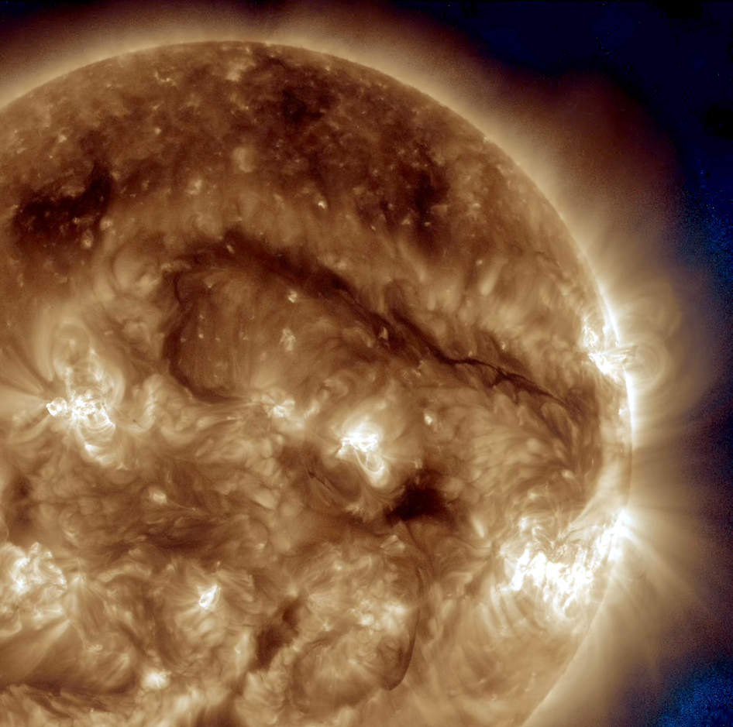
Fotosfera - Filamento
Notes:
http://www.nasa.gov/content/goddard/sdo-watches-giant-filament-193-335-wavelength/#.VkOTo15LeWM
SDO Watches Giant Filament - 193+335 Wavelength
A dark snaking line in the upper right of this image on Sept. 30, 2014, show a filament of solar material hovering above the sun's surface.If straightened out, the filament would reach almost across the whole sun, about 1 million miles or 100 times the size of Earth. NASA's Solar Dynamics Observatory, or SDO, captured the image in extreme UV light of 193 Angstrom and 335 Angstrom – different colors represent different wavelengths of light and different temperatures of solar material. Credit: NASA/SDO
http://www.nasa.gov/content/goddard/sdo-watches-giant-filament-on-the-sun/#.VkOT_15LeWN

Slide 51
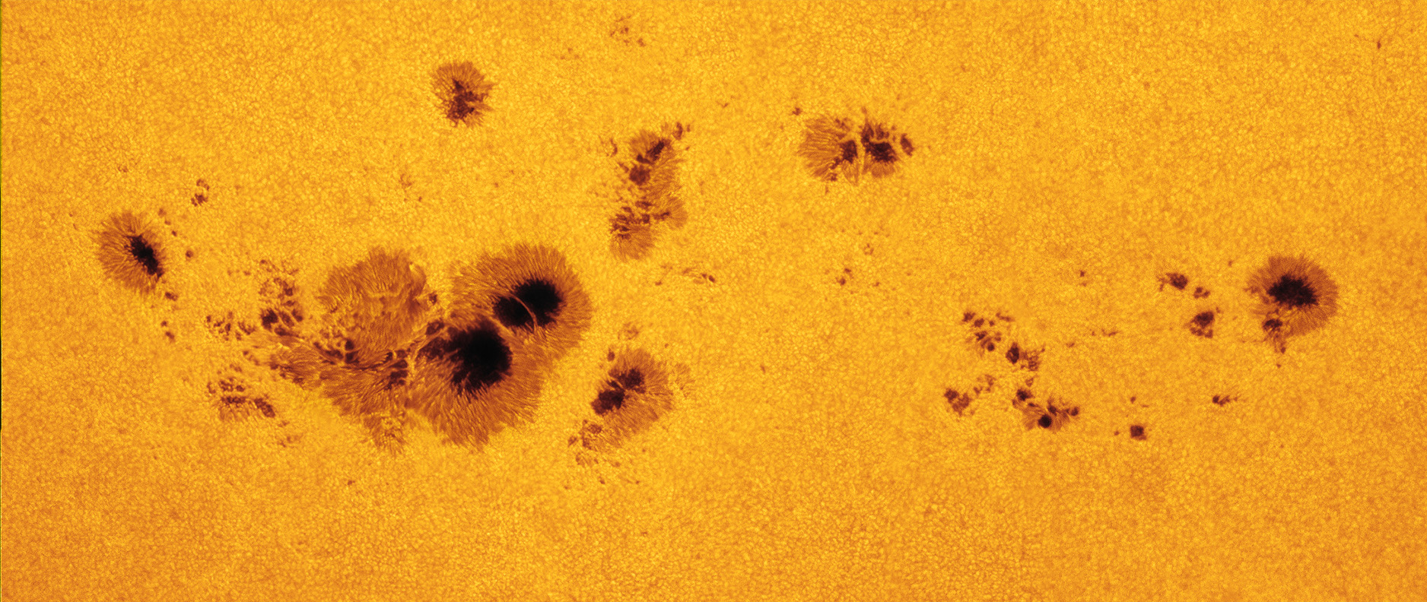
Fotosfera
Mancha Solar
Notes:
https://en.wikipedia.org/wiki/Sunspot#/media/File:Solar_Archipelago_-_Flickr_-_NASA_Goddard_Photo_and_Video.jpg
A group of sunspots, labeled as Active Region 1520 rotated into view over the left side of the sun on July 7, 2012. The large spot on the bottom left stretches more than 11 Earths, or 87,000 miles across. The full chain of spots is closer to 200,000 miles across. This image was captured by amateur astronomer Alan Friedman on July 10.
Image courtesy of Alan Friedman
NASA image use policy.
NASA Goddard Space Flight Center enables NASA’s mission through four scientific endeavors: Earth Science, Heliophysics, Solar System Exploration, and Astrophysics. Goddard plays a leading role in NASA’s accomplishments by contributing compelling scientific knowledge to advance the Agency’s mission.
https://en.wikipedia.org/wiki/Sunspot
Sunspots are temporary phenomena on the photosphere of the Sun that appear visibly as dark spots compared to surrounding regions. They correspond to concentrations of magnetic field flux that inhibit convection and result in reduced surface temperature compared to the surrounding photosphere. Sunspots usually appear in pairs, with pair members of opposite magnetic polarity.^{[2]} The number of sunspots varies according to the approximately 11-year solar cycle.
Individual sunspots may endure anywhere from a few days to a few months, but eventually decay. Sunspots expand and contract as they move across the surface of the Sun with a size ranging from 16 kilometers (10 mi)^{[3]} to 160,000 kilometers (100,000 mi)^{[4]} in diameter. The larger variety are visible from Earth without the aid of a telescope.^{[5]} They may travel at relative speeds ("proper motions") of a few hundred meters per second when they first emerge.
Reflecting intense magnetic activity, sunspots accompany secondary phenomena such as coronal loops (prominences) and reconnection events. Most solar flares and coronal mass ejections originate in magnetically active regions around visible sunspot groupings. Similar phenomena indirectly observed on stars other than the sun are commonly called starspots and both light and dark spots have been measured.^{[6]}

Slide 52
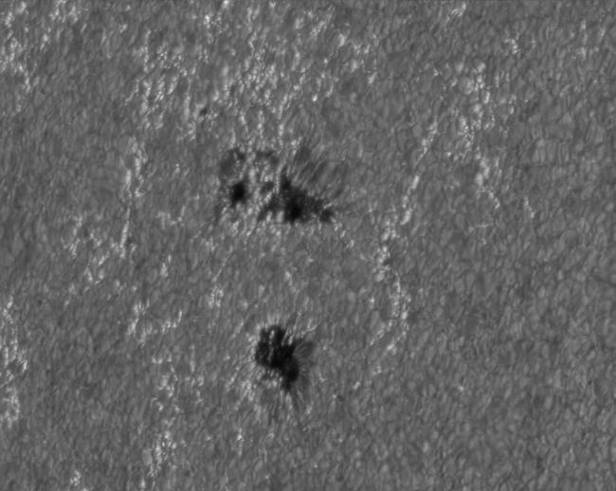
Fotosfera - Fácula
Notes:
http://solarscience.msfc.nasa.gov/images/faculae.jpg
Faculae
Faculae are bright areas that are usually most easily seen near the limb, or edge, of the solar disk. These are also magnetic areas but the magnetic field is concentrated in much smaller bundles than in sunspots. While the sunspots tend to make the Sun look darker, the faculae make it look brighter. During a sunspot cycle the faculae actually win out over the sunspots and make the Sun appear slightly (about 0.1%) brighter at sunspot maximum that at sunspot minimum.

Slide 53
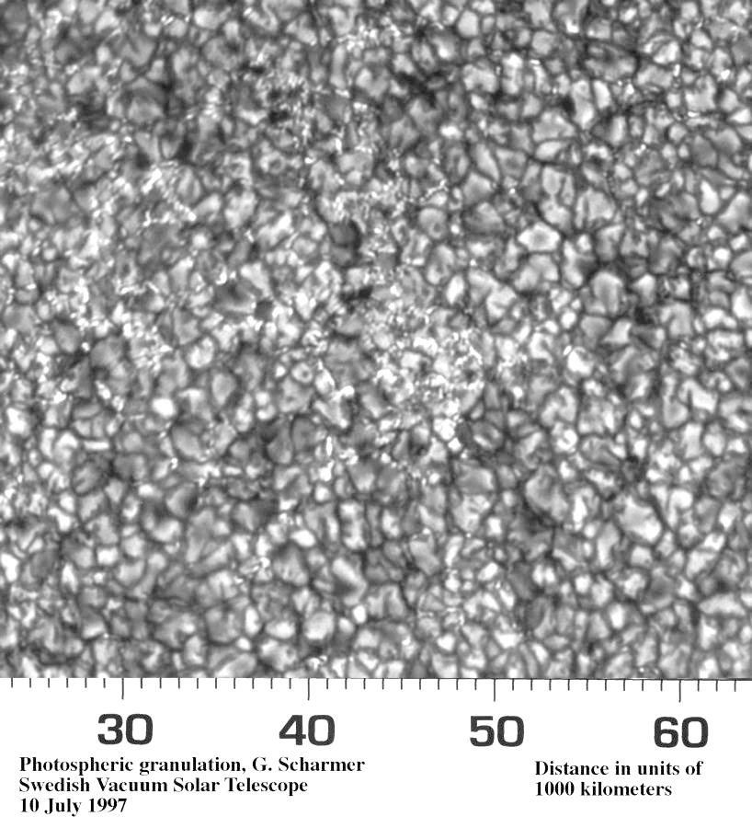
Fotosfera - Granulação
Notes:
http://solarscience.msfc.nasa.gov/images/granules.jpg
Granules are small (about 1000 km across) cellular features that cover the entire Sun except for those areas covered by sunspots. These features are the tops of convection cells where hot fluid rises up from the interior in the bright areas, spreads out across the surface, cools and then sinks inward along the dark lanes. Individual granules last for only about 20 minutes. The granulation pattern is continually evolving as old granules are pushed aside by newly emerging ones (470 kB MPEG movie from the Swedish Vacuum Solar Telescope). The flow within the granules can reach supersonic speeds of more than 7 km/s (15,000 mph) and produce sonic "booms" and other noise that generates waves on the Sun's surface.

Slide 54

Fotosfera - Granulação
Notes:
http://solarscience.msfc.nasa.gov/images/granules.jpg
Granules are small (about 1000 km across) cellular features that cover the entire Sun except for those areas covered by sunspots. These features are the tops of convection cells where hot fluid rises up from the interior in the bright areas, spreads out across the surface, cools and then sinks inward along the dark lanes. Individual granules last for only about 20 minutes. The granulation pattern is continually evolving as old granules are pushed aside by newly emerging ones (470 kB MPEG movie from the Swedish Vacuum Solar Telescope). The flow within the granules can reach supersonic speeds of more than 7 km/s (15,000 mph) and produce sonic "booms" and other noise that generates waves on the Sun's surface.

Slide 55

Fotosfera - Supergranulação
Notes:
http://solarscience.msfc.nasa.gov/images/supergranules.jpg
Supergranules are much larger versions of granules (about 35,000 km across) but are best seen in measurements of the "Doppler shift" where light from material moving toward us is shifted to the blue while light from material moving away from us is shifted to the red. These features also cover the entire Sun and are continually evolving. Individual supergranules last for a day or two and have flow speeds of about 0.5 km/s (1000 mph). The fluid flows observed in supergranules carry magnetic field bundles to the edges of the cells where they produce the chromospheric network.

Slide 56

Estrutura Interna - Zona de Convecção
Notes:
http://solarscience.msfc.nasa.gov/images/cutaway.jpg
solarscience.msfc.nasa.gov/interior.shtml
The Convection Zone
Click on image for larger version.
The convection zone is the outer-most layer of the solar interior. It extends from a depth of about 200,000 km right up to the visible surface. At the base of the convection zone the temperature is about 2,000,000° C. This is "cool" enough for the heavier ions (such as carbon, nitrogen, oxygen, calcium, and iron) to hold onto some of their electrons. This makes the material more opaque so that it is harder for radiation to get through. This traps heat that ultimately makes the fluid unstable and it starts to "boil" or convect.
Convection occurs when the temperature gradient (the rate at which the temperature falls with height or radius) gets larger than the adiabatic gradient (the rate at which the temperature would fall if a volume of material were moved higher without adding heat). Where this occurs a volume of material moved upward will be warmer than its surroundings and will continue to rise further. These convective motions carry heat quite rapidly to the surface. The fluid expands and cools as it rises. At the visible surface the temperature has dropped to 5,700 K and the density is only 0.0000002 gm/cm³ (about 1/10,000th the density of air at sea level). The convective motions themselves are visible at the surface as granules and supergranules.
https://en.wikipedia.org/wiki/Convection_zone
A convection zone, convective zone or convective region of a star is a layer which is unstable to convection. Energy is primarily or partially transported by convection in such a region. In a radiation zone, energy is transported by radiation and conduction.
Stellar convection consists of mass movement of plasma within the star which usually forms a circular convection current with the heated plasma ascending and the cooled plasma descending.
The Schwarzschild criterion expresses the conditions under which a region of a star is unstable to convection. A parcel of gas that rises slightly will find itself in an environment of lower pressure than the one it came from. As a result, the parcel will expand and cool. If the rising parcel cools to a lower temperature than its new surroundings, so that it has a higher density than the surrounding gas, then its lack of buoyancy will cause it to sink back to where it came from. However, if the temperature gradient is steep enough (i. e. the temperature changes rapidly with distance from the center of the star), or if the gas has a very high heat capacity (i. e. its temperature changes relatively slowly as it expands) then the rising parcel of gas will remain warmer and less dense than its new surroundings even after expanding and cooling. Its buoyancy will then cause it to continue to rise. The region of the star in which this happens is the convection zone

Slide 57


Estrutura Interna - Tachocline
Notes:
http://solarscience.msfc.nasa.gov/images/Dalsgaard1_T_vs_r.jpg
solarscience.msfc.nasa.gov/interior.shtml
The Interface Layer (Tachocline)
Click on image for larger version.
The interface layer lies between the radiative zone and the convective zone. The fluid motions found in the convection zone slowly disappear from the top of this layer to its bottom where the conditions match those of the calm radiative zone. This thin layer has become more interesting in recent years as more details have been discovered about it.
It is now believed that the Sun's magnetic field is generated by a magnetic dynamo in this layer. The changes in fluid flow velocities across the layer (shear flows) can stretch magnetic field lines of force and make them stronger. This change in flow velocity gives this layer its alternative name - the tachocline. There also appears to be sudden changes in chemical composition across this layer.
https://upload.wikimedia.org/wikipedia/commons/8/86/Tachocline.gif
Internal rotation in the Sun, showing differential rotation in the outer convective region and almost uniform rotation in the central radiative region. The transition between these regions is called the tachocline. Image courtesy of GONG: http://gong.nso.edu/
https://en.wikipedia.org/wiki/Tachocline
The tachocline is the transition region of the Sun between the radiative interior and the differentially rotating outer convective zone. It is in the outer third of the Sun (by radius). This causes the region to have a very large shear as the rotation rate changes very rapidly. The convective exterior rotates as a normal fluid with differential rotation with the poles rotating slowly and the equator rotating quickly. The radiative interior exhibits solid-body rotation, possibly due to a fossil field. The rotation rate through the interior is roughly equal to the rotation rate at mid-latitudes, i.e. in-between the rate at the slow poles and the fast equator. Recent results from helioseismology indicate that the tachocline is located at a radius of at most 0.70 times the Solar radius (measured from the core, i.e., the surface is at 1 solar radius), with a thickness of 0.04 times the solar radius. This would mean the area has a very large shear profile that is one way that large scale magnetic fields can be formed. The geometry and width of the tachocline plays an important role in models of the solar dynamo by winding up weaker poloidal field to create a much stronger toroidal field. The term tachocline was coined in a paper by Edward Spiegel and Jean-Paul Zahn in 1992^{[1]} by analogy to the oceanic thermocline.

Slide 58

Estrutura Interna - Zona de Radiação
Notes:
http://www.prof2000.pt/users/angelof/af16/ts_sol/big_images/bigsol7.png
http://www.prof2000.pt/users/angelof/af16/ts_sol/estrutura_interna_producao_energia.htm
Produção e transporte da energia
A energia que é libertada no interior do Sol é, na proporção de 98 %, importada pelos fotões gama, o resto é-o pelos neutrinos. A radiação visível do Sol, que nos provém da fotosfera, é constituída por fotões que emitidos sob a forma de radiação gama no centro da estrela, demoram vários milhões de anos para atingir a superfície, perdendo a pouco e pouco a sua energia em cada difusão. Em contrapartida, os neutrinos atravessam o Sol sem dificuldade, em apenas dois segundos.
http://solarscience.msfc.nasa.gov/interior.shtml
The Radiative Zone
Click on image for larger version.
The radiative zone extends outward from the outer edge of the core to the interface layer or tachocline at the base of the convection zone (from 25% of the distance to the surface to 70% of that distance). The radiative zone is characterized by the method of energy transport - radiation. The energy generated in the core is carried by light (photons) that bounces from particle to particle through the radiative zone.
Although the photons travel at the speed of light, they bounce so many times through this dense material that an individual photon takes about a million years to finally reach the interface layer. The density drops from 20 g/cm³ (about the density of gold) down to only 0.2 g/cm³ (less than the density of water) from the bottom to the top of the radiative zone. The temperature falls from 7,000,000° C to about 2,000,000° C over the same distance.

Slide 59

Estrutura Interna - Núcleo
Notes:
http://solarscience.msfc.nasa.gov/images/Dalsgaard1_density_vs_r.jpg
http://solarscience.msfc.nasa.gov/interior.shtml
The Core
The Sun's core is the central region where nuclear reactions consume hydrogen to form helium. These reactions release the energy that ultimately leaves the surface as visible light. These reactions are highly sensitive to temperature and density. The individual hydrogen nuclei must collide with enough energy to give a reasonable probability of overcoming the repulsive electrical force between these two positively charged particles. The temperature at the very center of the Sun is about 15,000,000° C (27,000,000° F) and the density is about 150 g/cm³ (approximately 10 times the density of gold, 19.3 g/cm³ or lead, 11.3 g/cm³). Both the temperature and the density decrease as one moves outward from the center of the Sun. The nuclear burning is almost completely shut off beyond the outer edge of the core (about 25% of the distance to the surface or 175,000 km from the center). At that point the temperature is only half its central value and the density drops to about 20 g/cm³.
https://en.wikipedia.org/wiki/Solar_core
The core of the Sun is considered to extend from the center to about 0.2 to 0.25 solar radius.^{[1]} It is the hottest part of the Sun and of the Solar System. It has a density of 150 g/cm³ (150 times the density of liquid water) at the center, and a temperature of 15 million degrees Celsius.^{[2]} The core is made of hot, dense gas in the plasmic state (ions and electrons), at a pressure estimated at 265 billion bar (26.5 petapascals (PPa) or 3.84 trillion psi) at the center.
The core inside 0.20 of the solar radius, contains 34% of the Sun's mass, but only 0.8% of the Sun's volume. Inside 0.24 solar radius, the core generates 99% of the fusion power of the Sun. There are two distinct reactions in which four hydrogen nuclei may eventually result in one helium nucleus: the proton-proton chain reaction – which is responsible for most of the Sun's released energy – and the CNO cycle.
Approximately 3.6×10³⁸ protons (hydrogen nuclei) are converted into helium nuclei every second releasing energy at a rate of 3.86×10²⁶ joules per second.^{[3]}
The core produces almost all of the Sun's heat via fusion: the rest of the star is heated by the outward transfer of heat from the core. The energy produced by fusion in the core, except a small part carried out by neutrinos, must travel through many successive layers to the solar photosphere before it escapes into space as sunlight or kinetic energy of particles. The energy conversion per unit time (power) of fusion in the core varies with distance from the solar center. At the center of the Sun, fusion power is estimated by models to be about 276.5 watts/m³.^{[4]} Despite its intense temperature, the peak power generating density of the core overall is similar to an active compost heap, and is lower than the power density produced by the metabolism of an adult human. The Sun is much hotter than a compost heap due to the Sun's enormous volume.^{[5]}
The low power outputs occurring inside the fusion core of the Sun may also be surprising, considering the large power which might be predicted by a simple application of the Stefan–Boltzmann law for temperatures of 10 to 15 million kelvin. However, layers of the Sun are radiating to outer layers only slightly lower in temperature, and it is this difference in radiation powers between layers which determines net power generation and transfer in the solar core.
At 19% of the solar radius, near the edge of the core, temperatures are about 10 million kelvin and fusion power density is 6.9 W/m³, which is about 2.5% of the maximum value at the solar center. The density here is about 40 g/cm³, or about 27% of that at the center.^{[6]} Some 91% of the solar energy is produced within this radius. Within 24% of the radius (the outer "core" by some definitions), 99% of the Sun's power is produced. Beyond 30% of the solar radius, where temperature is 7 million K and density has fallen to 10 g/cm³ the rate of fusion is almost nil.^{[7]} There are two distinct reactions in which 4 H nuclei may eventually result in one He nucleus: "proton-proton chain reaction" and the "CNO cycle"

Slide 60
Sequência Proton - Proton
Notes:
http://csep10.phys.utk.edu/ojta/c2c/ordinary_stars/stages/p-p_tl.html
http://csep10.phys.utk.edu/ojta/c2c/ordinary_stars/stages/ppS.html
http://csep10.phys.utk.edu/ojta/c2c/ordinary_stars/stages/ppchain_ic/frame.html

Slide 61

Notes:
http://csep10.phys.utk.edu/ojta/c2c/ordinary_stars/stages/beta_decayS.html

Slide 62

Notes:
http://csep10.phys.utk.edu/ojta/c2c/ordinary_stars/stages/ppS.html

Slide 63

TRACE
Notes:
https://upload.wikimedia.org/wikipedia/commons/c/ca/Tracemosaic.jpg
This is a false-color, 3-layer composite from the TRACE observatory showing the solar corona: the blue, green, and red channels show the 171Å, 195Å, and 284Å, respectively. These TRACE filters are most sensitive to emission from 1, 1.5, and 2 million degree plasma, thus showing the entire corona and detail of coronal loops in the lower solar atmosphere). The image shows the corona for a moderately active Sun, with some (red) hot active regions in both hemispheres, surrounded by the (blue/green) cooler plasma of the quiet-Sun corona. Notice the multitude of relatively cool loops connecting the active regions on both hemispheres.
Date 2 August 1999
https://en.wikipedia.org/wiki/TRACE
Transition Region and Coronal Explorer (TRACE) was a NASA heliophysics and solar observatory designed to investigate the connections between fine-scale magnetic fields and the associated plasma structures on the Sun by providing high resolution images and observation of the solar photosphere and transition region to the corona. A main focus of the TRACE instrument is the fine structure of coronal loops low in the solar atmosphere. TRACE is the fourth spacecraft in the Small Explorer program, launched on April 2, 1998, and obtaining its last science image in 2010.^{[6]}
The satellite was built by NASA's Goddard Space Flight Center. Its telescope was constructed by a consortium led by Lockheed Martin's Advanced Technology Center. The optics were designed and built to a state-of-the-art surface finish by the Smithsonian Astrophysical Observatory (SAO). The telescope has a 30 cm (12 in) aperture and 1024×1024 CCD detector giving an 8.5 arc minute field of view. The telescope is designed to take correlated images in a range of wavelengths from visible light through the Lyman alpha line to far ultraviolet. The different wavelength passbands correspond to plasma emission temperatures from 4,000 to 4,000,000 K. The optics use a special multilayer technique to focus the difficult-to-reflect EUV light; the technique was first used for solar imaging in the late 1980s and 1990s, notably by the MSSTA and NIXT sounding rocket payloads.

Slide 64
FIM DA APRESENTAÇÃO

