Slide 1



Centro de Divulgação da Astronomia
Observatório Dietrich Schiel
Formação do Sistema Solar e Sistemas Exoplanetários
Jorge Hönel
Observatório Dietrich Schiel
/CDCC/USP
Imagem de fundo: céu de São Carlos na data de fundação do observatório Dietrich Schiel (10/04/86, 20:00 TL) crédito: Stellarium

Slide 2
19 de junho, aula 4:
formação do Sistema Solar;
exoplanetas: sub anãs marrons, júpiteres quentes, superterras e planetas semelhantes à Terra;
faixa de habitabilidade;
métodos de detecção de exoplanetas.

Slide 3
Formação do Sistema Solar

Slide 4
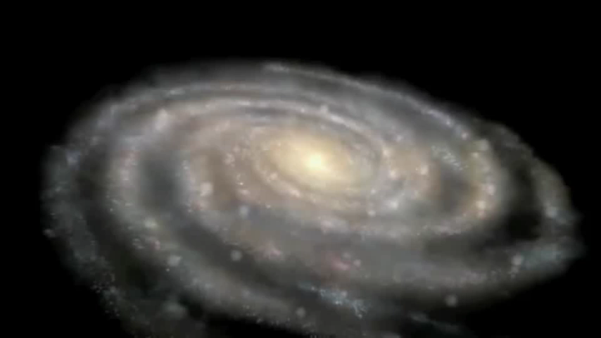
Notes:
https://www.youtube.com/watch?v=Uhy1fucSRQI
Stephen Hawking - Formation of the Solar System

Slide 5
Fora do Sistema Solar: exoplanetas ou planetas extrassolares

Slide 6
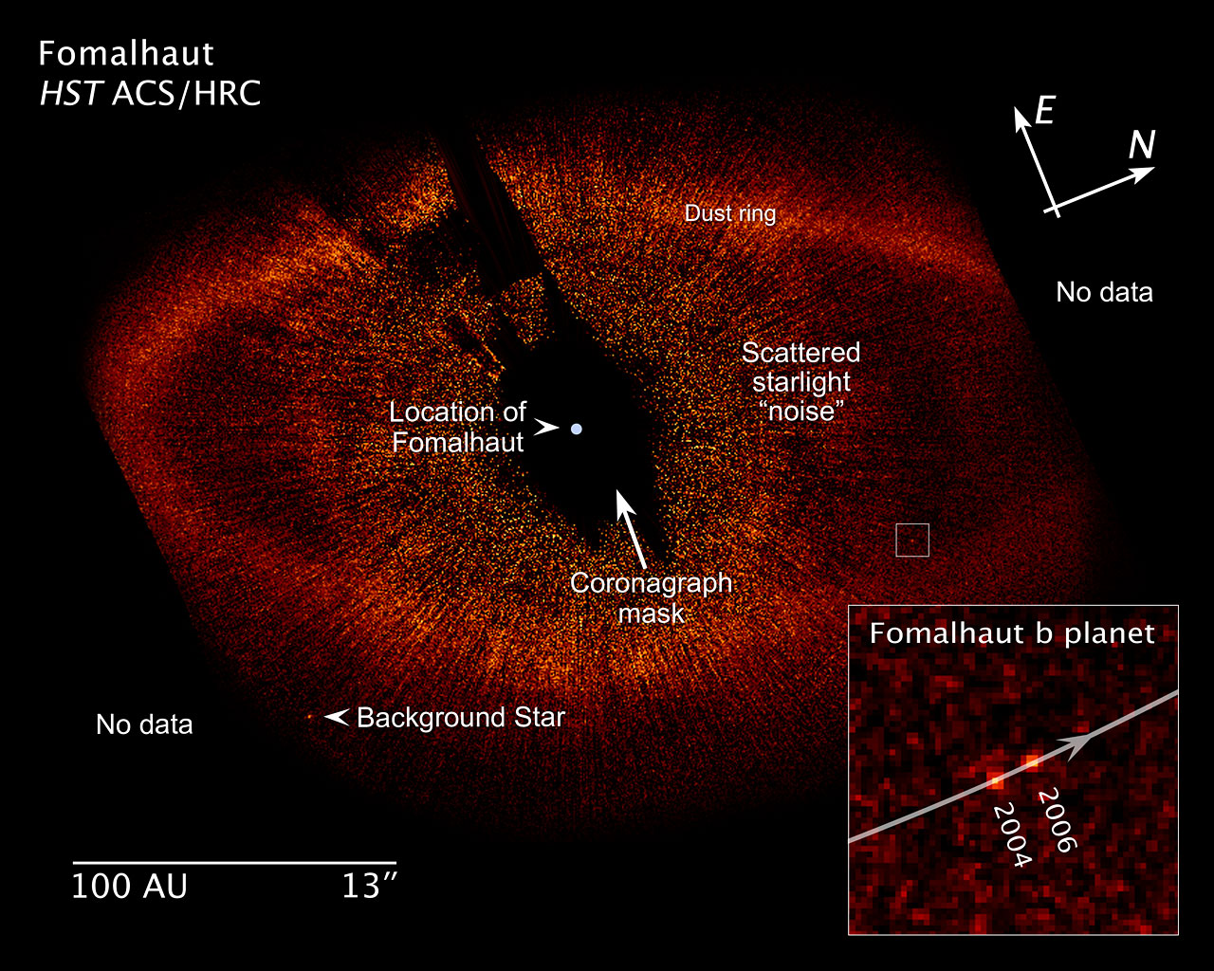
Notes:
http://cdn.spacetelescope.org/archives/images/screen/heic0821e.jpg
https://www.spacetelescope.org/images/heic0821e/
This annotated image shows key features of the Fomalhaut system, including the newly discovered planet Fomalhaut b, and the dust ring. Also included are a distance scale and an insert, showing how the planet has moved around its parent star over the course of 21 months. The Fomalhaut system is located approximately 25 light-years from the Earth.
http://hubblesite.org/newscenter/archive/releases/2008/39/
NOVEMBER 13, 2008: Astronomers using NASA's Hubble Space Telescope have taken the first visible-light snapshot of a planet orbiting another star. The images show the planet, named Fomalhaut b, as a tiny point source of light orbiting the nearby, bright southern star Fomalhaut, located 25 light-years away in the constellation Piscis Australis. An immense debris disk about 21.5 billion miles across surrounds the star. Fomalhaut b is orbiting 1.8 billion miles inside the disk's sharp inner edge.

Slide 7
Faixa de habitabilidade

Slide 8
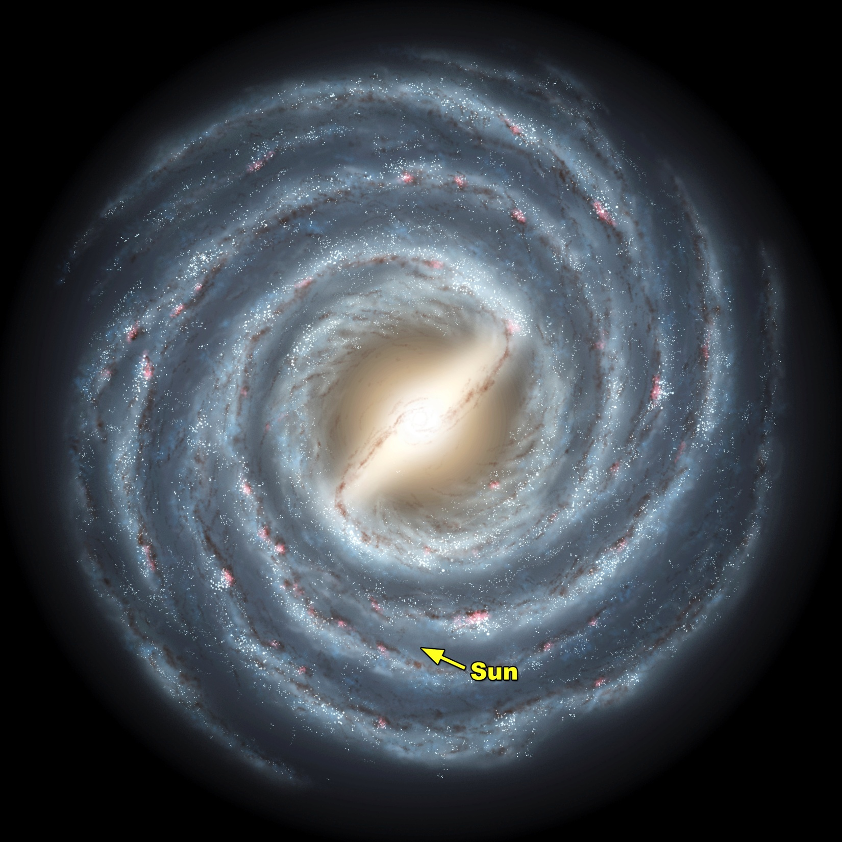
Notes:
Http://www.news.wisc.edu/newsphotos/images/Milky_Way_galaxy_sun05.jpg
http://www.news.wisc.edu/newsphotos/milkyway.html
Caption: The Milky Way, it turns out, is no ordinary spiral galaxy. According to a massive new survey of stars at the heart of the galaxy by Wisconsin astronomers, including professor of astonomy Edward Churchwell and professor of physics Robert Benjamin, the Milky Way has a definitive bar feature -- some 27,000 light years in length -- that distinguishes it from pedestrian spiral galaxies, as shown in this artist's rendering. The survey, conducted using NASA's Spitzer Space Telescope, sampled light from an estimated 30 million stars in the plane of the galaxy in an effort to build a detailed portrait of the inner regions of the Milky Way.
Illustration: NASA/JPL-Caltech/R. Hurt (SSC/Caltech)
Date: 2005

Slide 9
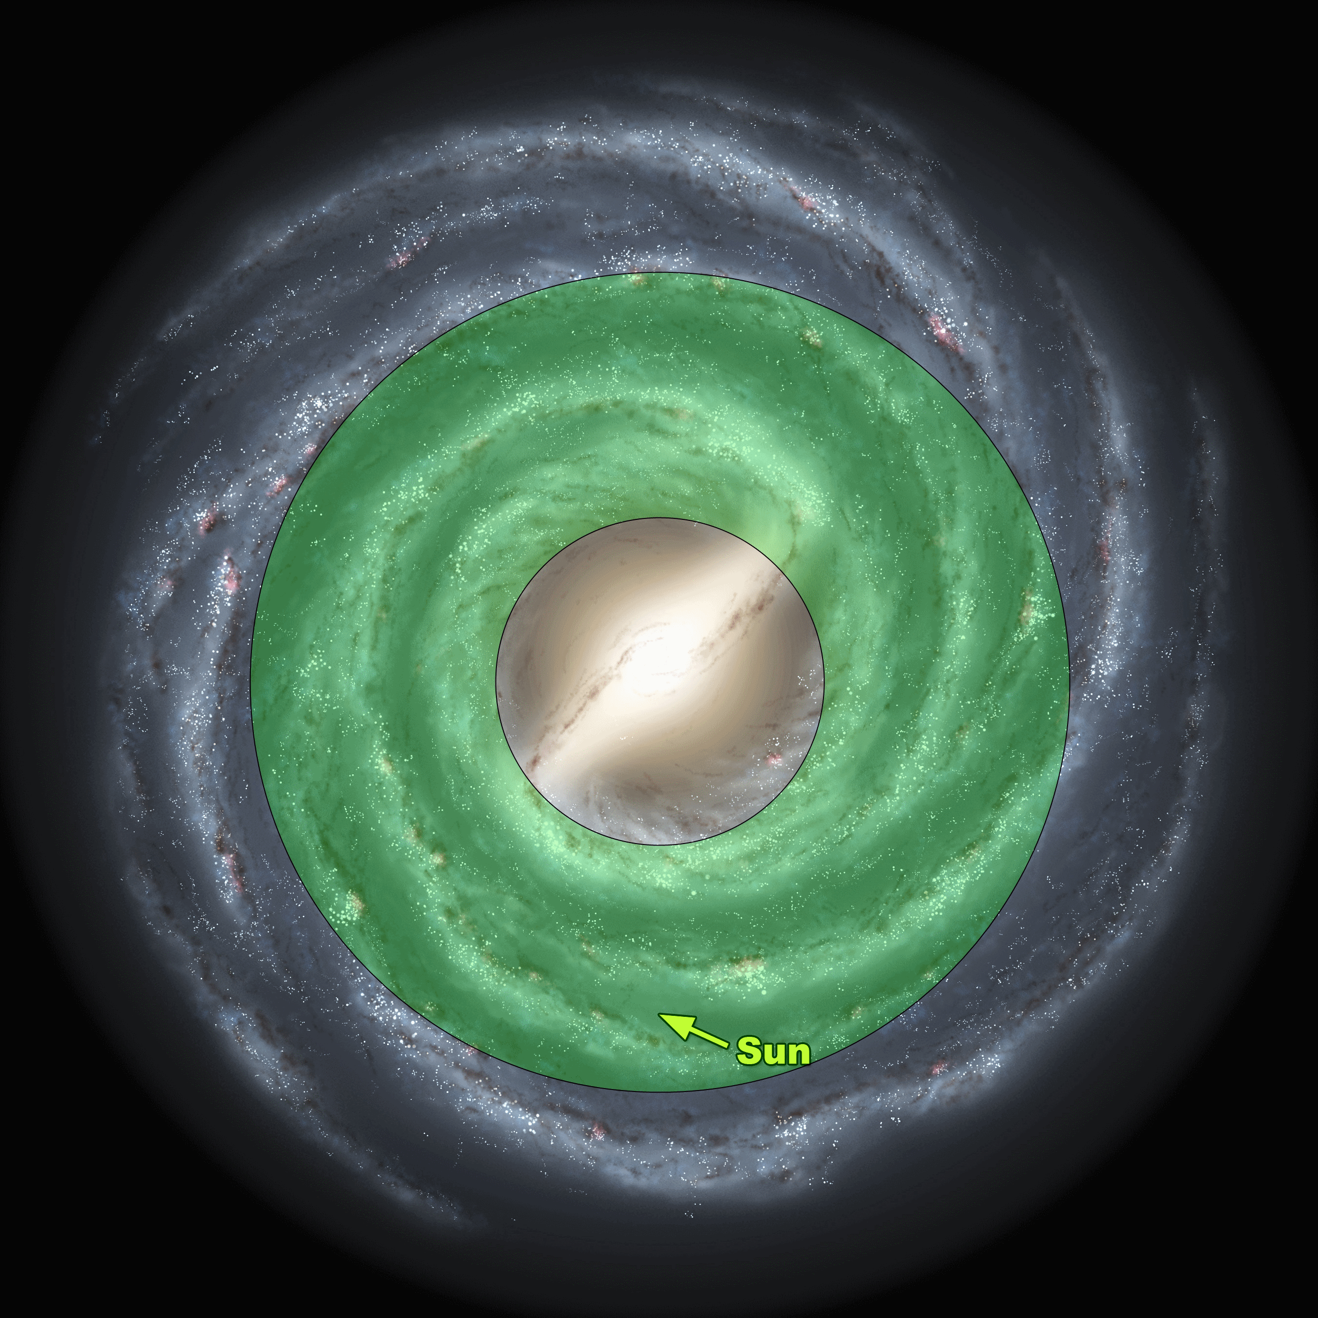
Notes:
https://upload.wikimedia.org/wikipedia/commons/3/3b/Milky_Way_galactic_habitable_zone.gif
This is the galactic habitable zone of the Milky Way, as predicted by Lineweaver et al (2004).
https://en.wikipedia.org/wiki/Galactic_habitable_zone

Slide 10
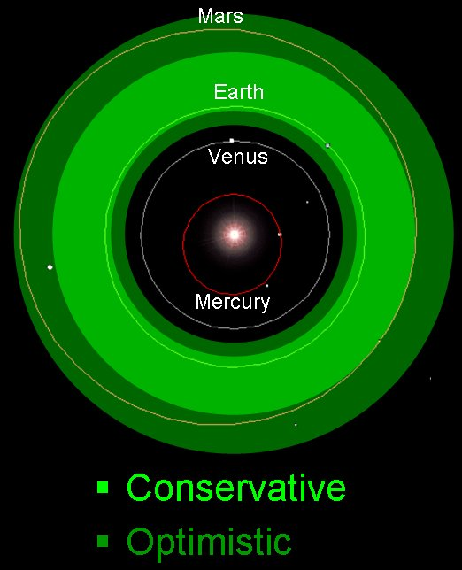
Notes:
http://www.astronomy.ohio-state.edu/~pogge/Ast161/Unit7/Images/HabitableZone.jpg
http://www.astronomy.ohio-state.edu/~pogge/Ast161/Unit7/life.html

Slide 11
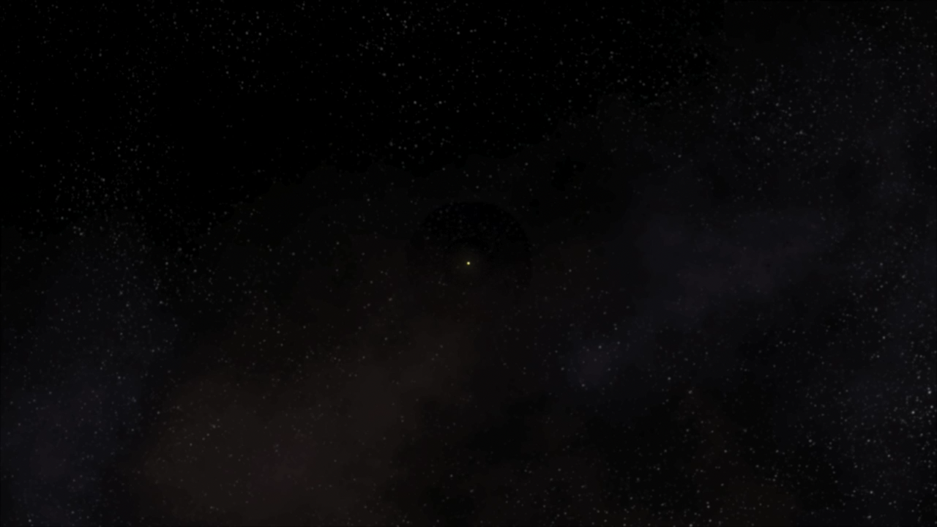
Notes:
http://kepler.nasa.gov/multimedia/animations/?ImageID=41
Comparative Life Zones of Stars (with text)
12/29/2009
The habitable zone is the distance from a star where one can have liquid water on the surface of a planet. If a planet is too close to its parent star, it will be too hot and water would have evaporated. If a planet is too far from a star it is too cold and water is frozen. Stars come in a wide variety of sizes, masses and temperatures. Stars that are smaller, cooler and lower mass than the Sun (M-dwarfs) have their habitable zone much closer to the star than the Sun (G-dwarf). Stars that are larger, hotter and more massive than the Sun (A-dwarfs) have their habitable zone much farther out from the star.

Slide 12
Simulador
da
Zona Habitável
Notes:
stellarHabitableZone.swf
http://www.cdcc.usp.br/cda/NAAP%20-%20Nebraska-Lincon/astroUNL/naap/habitablezones/habitablezones.html

Slide 13
Métodos de detecção

Slide 14
Técnicas:
Astrométrica
Velocidade radial
Fotométrica
  Trânsito
  Microlente gravitacional
Imageamento
Notes:
Crédito da imagem: NASA Ames / SETI Institute / JPL-CalTech.

Slide 15
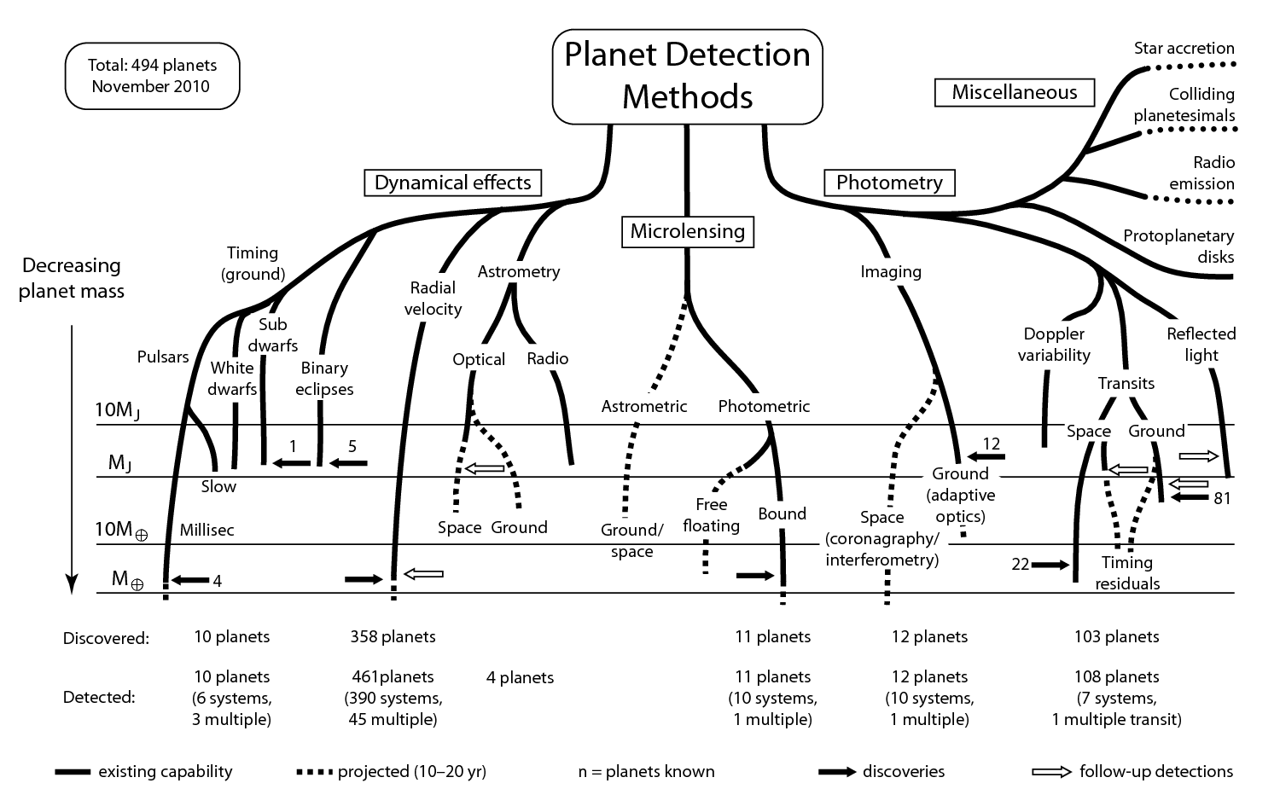

Slide 16
BAMBOLEIO
Como Medimos?
Opção 1
Opção 2
Notes:
http://www.cdcc.usp.br/cda/NAAP%20-%20Nebraska-Lincon/astroUNL/naap/esp/esp.html
hammerthrower.swf
radialvelocitydemo.swf
ca_extrasolarplanets_starwobble.swf

Slide 17
Tipos de Resultados!
Notes:
radialVelocitySimulator.swf
http://www.cdcc.usp.br/cda/NAAP%20-%20Nebraska-Lincon/astroUNL/naap/esp/esp.html

Slide 18
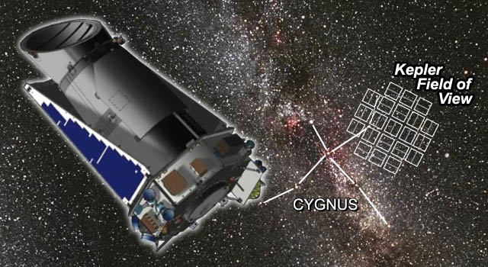
Kepler Mission
(NASA)
Procura por Planeta tipo Terra
Fotometria de 155 000 estrelas
Notes:
2012Fabrycky.ppt
http://astro.uchicago.edu/~fabrycky/Home.html

Slide 19
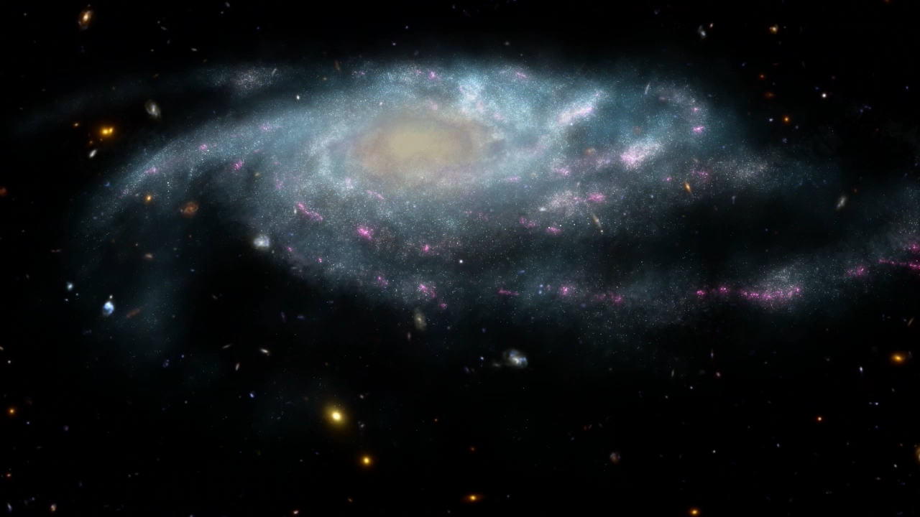
Notes:
kepler_diagram_GalacticView_fullsizeH264.mov
http://kepler.nasa.gov/multimedia/animations/?ImageID=36
View of the Galaxy
12/29/2009
Our Sun is just one out of over 200 billion stars in our galaxy, the Milky Way. The Sun is located in the Orion arm of our galaxy about 25,000 light years from the center of the Galaxy. Kepler will be examining over 100,000 stars in our neighborhood of our galaxy in the Cygnus and Lyra constellations. Most of these stars will be somewhere between 500 and 3,000 light years from our solar system.
Credit: NASA Kepler Mission/Dana Berry

Slide 20
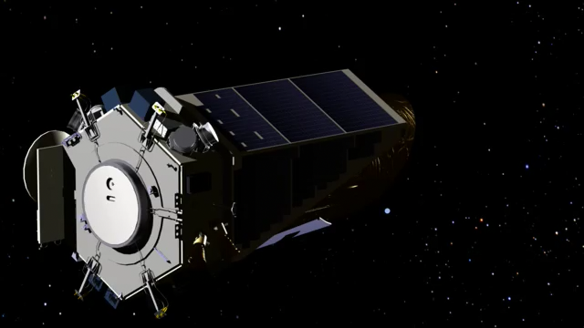
Notes:
http://kepler.nasa.gov/multimedia/animations/?ImageID=86
Range of Views
12/04/2008
An animation depicting various orbit geometries, some of which permit view of transits, and others that do not.
Credit: NASA Kepler Mission/Dana Berry
Credit: NASA/Kepler mission/Dana Berry

Slide 21
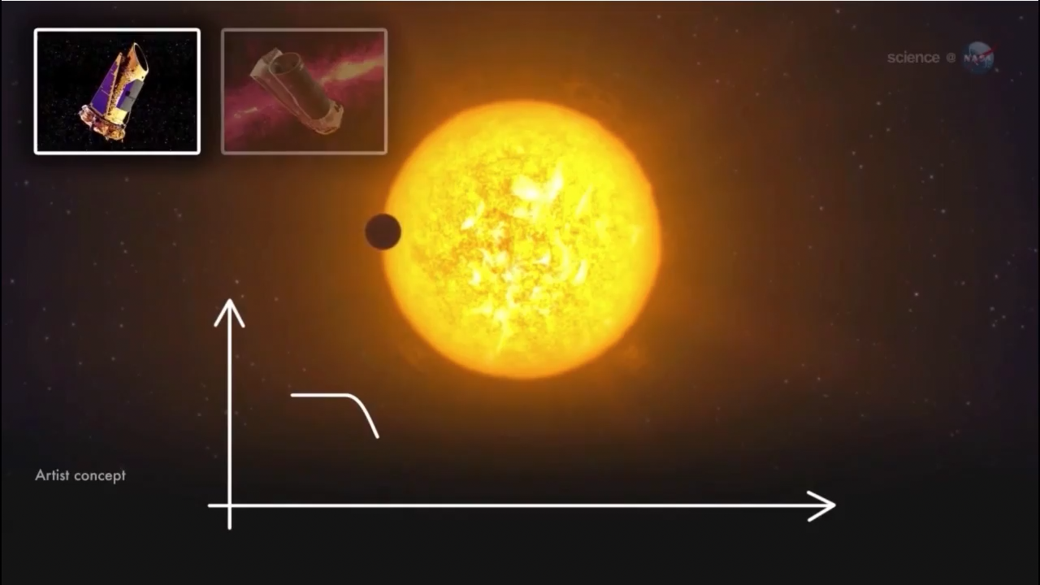
Trânsito
Notes:
transitAnimatoion2.mov
http://kepler.nasa.gov/multimedia/animations/?ImageID=297
Transit Graph 2
08/26/2014
This is a section of a NASA ScienceCast "Sizing Up and Exoplanet" at
http://www.nasa.gov/downloadable/videos/sciencecasts-_sizing_up_an_exoplanet_0.mp4.
Credit: NASA

Slide 22
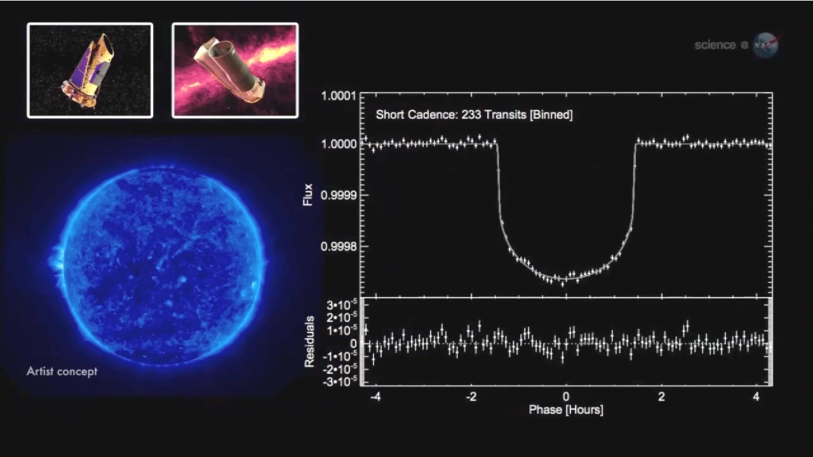
Notes:
transitAnimation1.mov
http://kepler.nasa.gov/multimedia/animations/?ImageID=296
Transit Graph 1
08/26/2014
This is a section of a NASA ScienceCast "Sizing Up and Exoplanet" at
http://www.nasa.gov/downloadable/videos/sciencecasts-_sizing_up_an_exoplanet_0.mp4
Credit: NASA

Slide 23
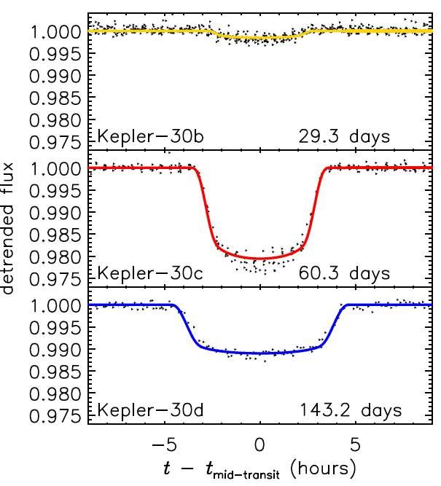
KOI-806 = Kepler-30
Fabrycky, Ford, Steffen et al. 2012
Notes:
2012Fabrycky.ppt
http://astro.uchicago.edu/~fabrycky/Home.html

Slide 24
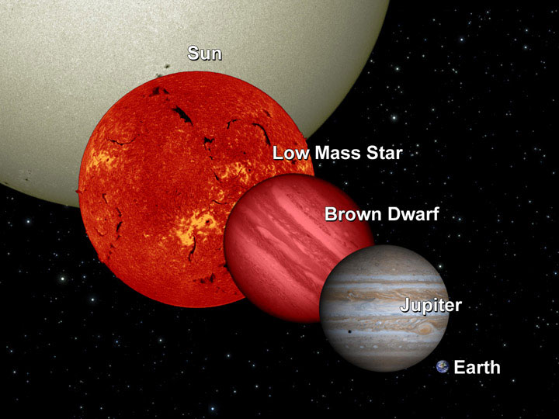
Anã Marrom
Notes:
https://en.wikipedia.org/wiki/Gliese_229
https://en.wikipedia.org/wiki/Brown_dwarf
https://upload.wikimedia.org/wikipedia/commons/4/40/BrownDwarfComparison-pia12462.jpg
Description General size comparison between a low mass star, a brown dwarf, and the planet Jupiter. In this image the brown dwarf is shown to be about 15% larger than Jupiter. The radii of brown dwarfs (13-75 M_{J}) vary by only 10–15% over the range of possible masses. Depending on the age and temperature, the transitingbrown dwarf COROT-3b has a diameter 1.01±0.07 times that of Jupiter.
Date 2009-Nov-17
SourceBrown Dwarf Comparison (pia12462)
AuthorNASA/JPL-Caltech/UCB

Slide 25
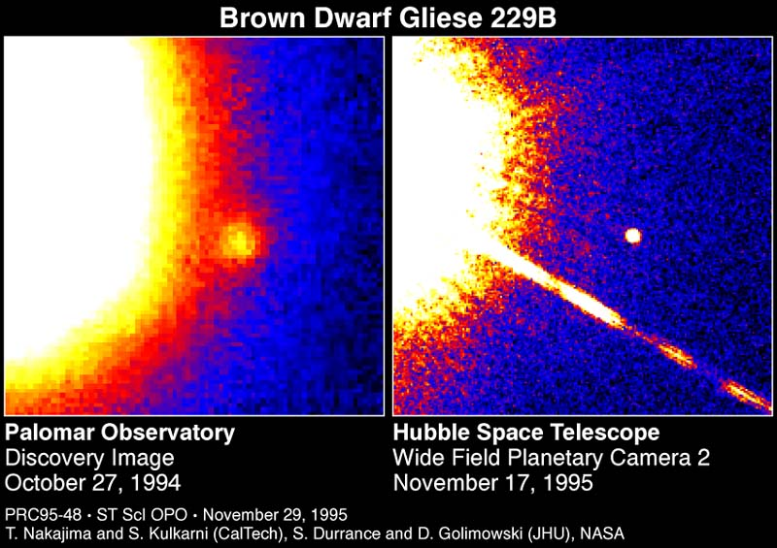
Notes:
https://en.wikipedia.org/wiki/Gliese_229
https://upload.wikimedia.org/wikipedia/commons/7/78/Brown_Dwarf_Gliese_229B.jpg
Summary
The smaller object is the Gliese 229B brown dwarf orbiting the star Gliese 229, which is located in the constellation Lepus about 19 light years from Earth. Gliese 229B is about 20 to 50 times the mass of Jupiter.
Source NASA: http://starchild.gsfc.nasa.gov/Images/StarChild/questions/brown_dwarf.jpg
Hubblesite STScI-1995-48: Astronomers Announce First Clear Evidence of a Brown Dwarf (November 29, 1995)

Slide 26
Alguns exoplanetas conhecidos

Slide 27
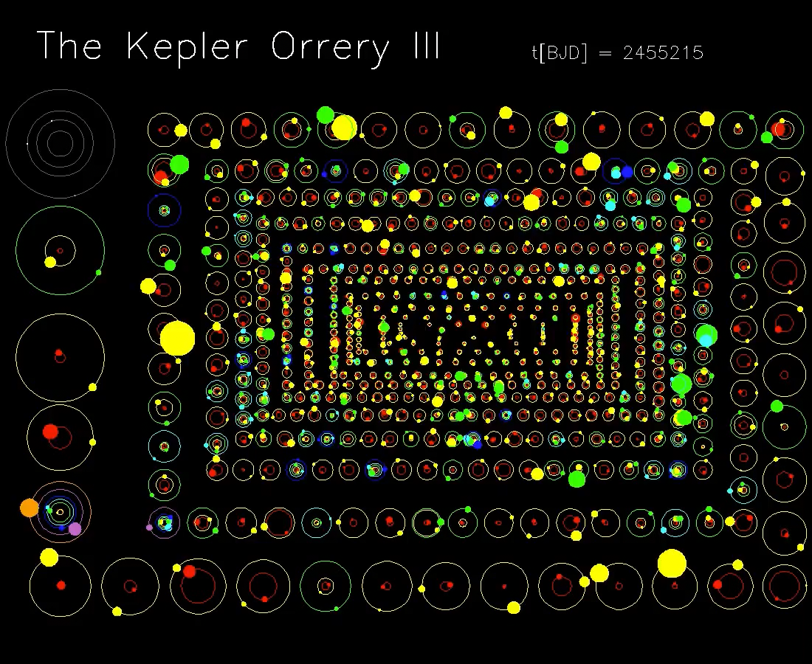
Notes:
orreyzoomd_ride.mp4
http://kepler.nasa.gov/multimedia/animations/?ImageID=219
Kepler Orrery II
03/11/2012
It is best to right click the large movie files and download them.
Daniel Fabrycky from the Kepler science team put together a visualization of all the multiple-planet systems discovered by the Kepler spacecraft as of February of 2011. This second version illustrates the planet candidates found as of Feb 2012: 885 planet candidates in 361 systems—double the number of systems in the original Kepler Orrery. The orbit radii are to scale with respect to each other and planet sizes are to scale with respect to each other, but orbits and planet sizes are different scales. The colors are in order of semi-major axis: two-planet systems (242 in all) have a yellow outer planet; 3-planet (85) green, 4-planet (25) light blue, 5-planet (8) dark blue, 6-planet (1, Kepler-11) purple.
See also New York Times interactive animation "Kepler's Tally of Planets"
Credit: Daniel Fabrycky

Slide 28
Contagem até o momento (14/10/2014 – fonte: http://planetquest.jpl.nasa.gov/newworldsatlas)
Total de descobertas: 5.029
Confirmados: 1.760
Estrelas com planetas: 1076
Sistemas multi-exoplanetários: 454
Gigantes gasosos: 426
Júpiteres quentes: 1038
Super terras:199
Terrestres: 80
Desconhecidos:17

Slide 29
amostra de“habitáveis”

Slide 30
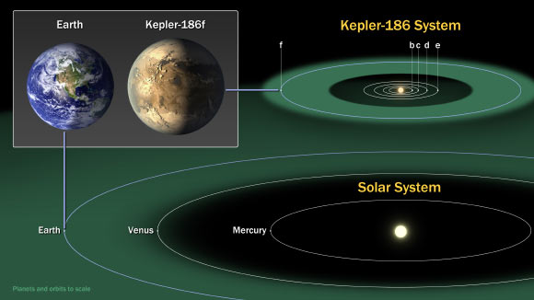
Kepler 186f: o mais parecido com a Terra
Cauda de poeira
Notes:
https://commons.wikimedia.org/wiki/File:Kepler186f-ComparisonGraphic-20140417.jpg
English: Kepler-186 and the Solar Systemhttp://www.nasa.gov/ames/kepler/kepler-186-and-the-solar-system
http://www.jpl.nasa.gov/news/news.php?release=2014-119
http://www.jpl.nasa.gov/spaceimages/details.php?id=PIA18000
The diagram compares the planets of our inner solar system to Kepler-186, a five-planet star system about 500 light-years from Earth in the constellation Cygnus. The five planets of Kepler-186 orbit an M dwarf, a star that is is half the size and mass of the sun.
The Kepler-186 system is home to Kepler-186f, the first validated Earth-size planet orbiting a distant star in the habitable zone—a range of distance from a star where liquid water might pool on the planet's surface. The discovery of Kepler-186f confirms that Earth-size planets exist in the habitable zones of other stars and signals a significant step toward finding a world similar to Earth.
The size of Kepler-186f is known to be less ten percent larger than Earth, but its mass and composition are not known. Kepler-186f orbits its star once every 130 days, receiving one-third the heat energy that Earth does from the sun. This places the planet near the outer edge of the habitable zone.
The inner four companion planets each measure less than fifty percent the size of Earth. Kepler-186b, Kepler-186c, Kepler-186d and Kepler-186, orbit every 4, 7, 13 and 22 days, respectively, making them very hot and inhospitable for life as we know it.
The Kepler space telescope infers the existence of a planet by the amount of starlight blocked when it passes in front of its star. From these data, a planet's radius, orbital period and the amount of energy recieved from the host star can be determined.
The artistic concept of Kepler-186f is the result of scientists and artists collaborating to imagine the appearance of these distant worlds.
Crédito da imagem: NASA Ames / SETI Institute / JPL-CalTech.

Slide 31
Kepler 186f
Distância: 500 a.l. (constelação de Cygnus)
Descoberta: 2014 (planeta mais próximo do tamanho da Terra numa zona habitável)
Massa: estimada em 1,44 M⊕ (se de composição similar à da Terra)
Período orbital: 129 dias
Notes:
Crédito da imagem: NASA Ames / SETI Institute / JPL-CalTech.

Slide 32
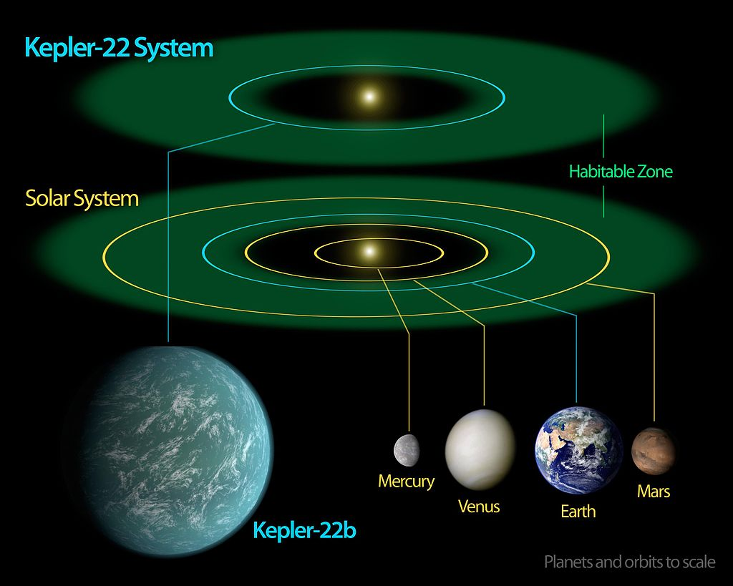
Kepler 22b (superterra dentro de uma ZH de estrela similar ao Sol)
Notes:
http://www.nasa.gov/sites/default/files/images/607773main_Kepler22bDiagram_raw_full.jpg
https://en.wikipedia.org/wiki/Kepler-22b
http://www.nasa.gov/mission_pages/kepler/multimedia/images/kepler-22b-diagram.html
Crédito da imagem: NASA Ames / SETI Institute / JPL-CalTech.

Slide 33
Kepler 22b
Distância: 600 a.l.
Descoberta: 2009 (primeiro exoplaneta descoberto em zona habitável numa estrela de mesmo tipo espectral do Sol e pelo método do trânsito)
Massa: <52,8 M⊕(superterra)
Período orbital: 290 dias
Notes:
Crédito da imagem: NASA Ames / SETI Institute / JPL-CalTech.

Slide 34
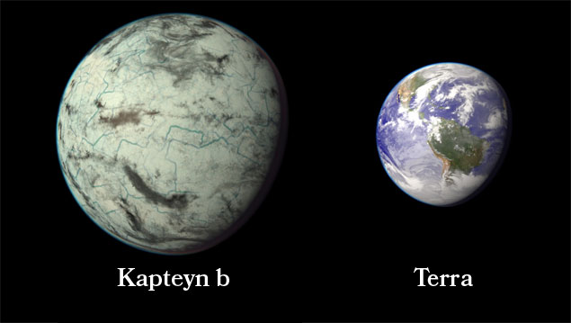
Kapteyn b: o mais próximo e o mais velho dos habitáveis
Cauda de poeira
Notes:
http://www.hpcf.upr.edu/~abel/phl/kapteyn/Kapteyn_b.jpg
http://phl.upr.edu/press-releases/kapteyn
https://en.wikipedia.org/wiki/Kapteyn_b
Crédito da imagem: wikipedia

Slide 35
Kapteyn b
Distância: 13 a.l. (constelação de Pictor)
Descoberta: 2014
Massa: 5 M⊕
Período orbital: 48 dias
Idade estimada: 11 bilhões de anos
Notes:
Crédito da imagem: NASA Ames / SETI Institute / JPL-CalTech.

Slide 36
Amostra de “exóticos”

Slide 37
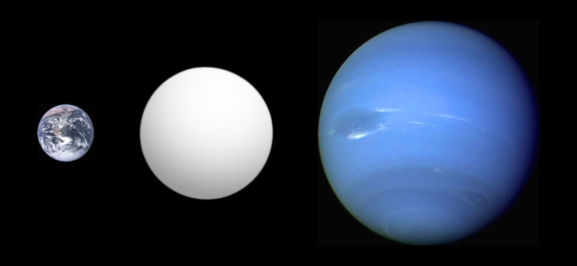
Kepler 10c – Godzilla das Terras
Cauda de poeira
2,3 vezes o tamanho da Terra
17 vezes mais massivo
Notes:
https://en.wikipedia.org/wiki/Kepler-10c
https://commons.wikimedia.org/wiki/File:Exoplanet_Comparison_Kepler-10_c.png
Description English: Comparison of best-fit size of the exoplanet Kepler-10c with the Solar System planets Earth and Neptune, as reported in the Open Exoplanet Catalogue^{[1]} as of 2014-06-16.Jump up↑ Open Exoplanet Catalogue (2010-09-30). Retrieved on 2010-09-30.
Date16 June 2014
SourceOwn work, incorporating public domain images for reference planets (see below), inspired by Thingg's size comparison
AuthorAldaron, a.k.a. Aldaron

Slide 38
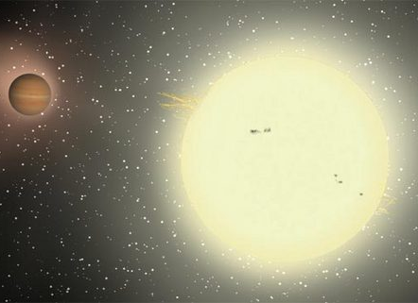
TrES-4 O maior
1,7 vezes o tamanho de Júpiter
Densidade 0,2 g.cm⁻³
Cauda de poeira
Notes:
Fonte da imagem: www.space.com
http://i.space.com/images/i/000/000/525/original/070806_big_exoplanet_02.jpg?1291331284
http://www.space.com/4151-largest-exoplanet-discovered.html
The largest exoplanet ever discovered is also one of the strangest and theoretically should not even exist, scientists say. Dubbed TrES-4, the planet is about 1.7 times the size of Jupiter and belongs to a small subclass of so-called puffy planets that have extremely low densities. The planet is located about 1,400 light years away from Earth and zips around its parent star in only three and a half days.
Credit: Jeffrey Hall, Lowell Observatory
https://en.wikipedia.org/wiki/TrES-4b

Slide 39
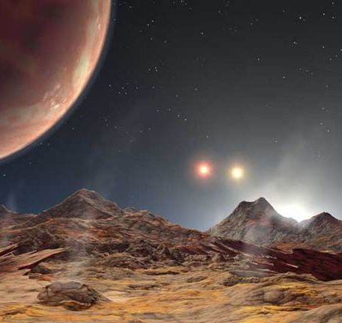
HD 188753 Ab: “Tatooine”
Planeta com “três sois”
Órbita a estrela principal semelhante ao Sol em 3,5 dias
Cauda de poeira
Notes:
Fonte da imagem: www.space.com
http://www.space.com/1311-triple-sunset-planet-discovered-3-star-system.html
http://i.space.com/images/i/000/001/103/original/050713_trinary_sunset_02.jpg?1292263440
This illustration shows an artist's conception of the three suns and the newly discovered Jupiter-sized planet from the perspective of a hypothetical moon orbiting the planet. The large yellow sun is already halfway over the horizon, but the orange and red suns are still visible in the sky.
Credit: NASA/JPL's Planetquest/Caltech
https://en.wikipedia.org/wiki/HD_188753

Slide 40

Notes:
https://www.youtube.com/watch?v=LSCfAJWC9qY

Slide 41
Referências
Picazzio, Enos (coordenador e editor), O céu que nos envolve: introdução à Astronomia para educadores e iniciantes. Editora Odisseus/CNPq,
www.cdcc.usp.br/cda
http://planetquest.jpl.nasa.gov
www.space.com
http://planetquest.jpl.nasa.gov/newworldsatlas
Notes:
Crédito da imagem: NASA Ames / SETI Institute / JPL-CalTech.

Slide 42

Notes:
Original:
Earth - Making Of A Planet – Youtube (1:31:28)
https://www.youtube.com/watch?v=Q_3PFfMdZ9c
Tribute to Earth Evolution no Youtube
https://www.youtube.com/watch?v=KCzXOxeY-60 (parte 1)
https://www.youtube.com/watch?v=KNrti-9_nOg (parte 2)

